Slide 1
THE VALUE OF YOU
What useful things can you
do with the resources you have

Slide 2
Brief for Teachers

Slide 3
The Value of You Programme
  Helps students see more clearly what resources they already have
  Discover what they can do with these resources
  Build the habit of creating greater value from them
  It guides and encourages students to
      Start from where they are (not lament what they don’t have)
      See what they have (many resources are as such invisible)
      Learn to use them well (not waste what they have)
      Build and improve (little and often leads to compounding)

Slide 4
How the Students Learn
  Students discover the ideas through activities, demonstrations, discussion, and reflection rather than being taught definitions.
Activity → Pause & Ponder → Discover → Apply

Slide 5
Making Students Future-Ready
  The future is uncertain.
  We cannot know what opportunities and problems students will face.
  But we can help them learn to recognise what they have, use it well, solve problems, create value, and keep learning and improving.
  You cannot prepare students for every future. You can prepare them to reinvent themselves for whatever future arrives.

Slide 6
Desired Learning Outcomes
  What we hope students will begin to do differently:
  Notice resources they previously overlooked
  Make more deliberate choices about time, energy, attention, health, knowledge, skills, technology…
  Not stop at, “I don't have enough” instead ask “What can I do with what I have?”
  Identify needs and problems around them
  Attitudinal shift - I can learn, make, solve, and help

Slide 7
Workshop Sample Activities
  Rubber-band exercise: goals, beliefs and constraints
  Marshmallow challenge: attention and delayed gratification
  Problem hunt (Manak): find something useful to improve for someone
  Time: You have one minute. Do something useful.
  Technology: AI as a personal tutor, make learning fun, judicious use (don’t outsource thinking)

Slide 8
Workshop Slides - for Students

Slide 9
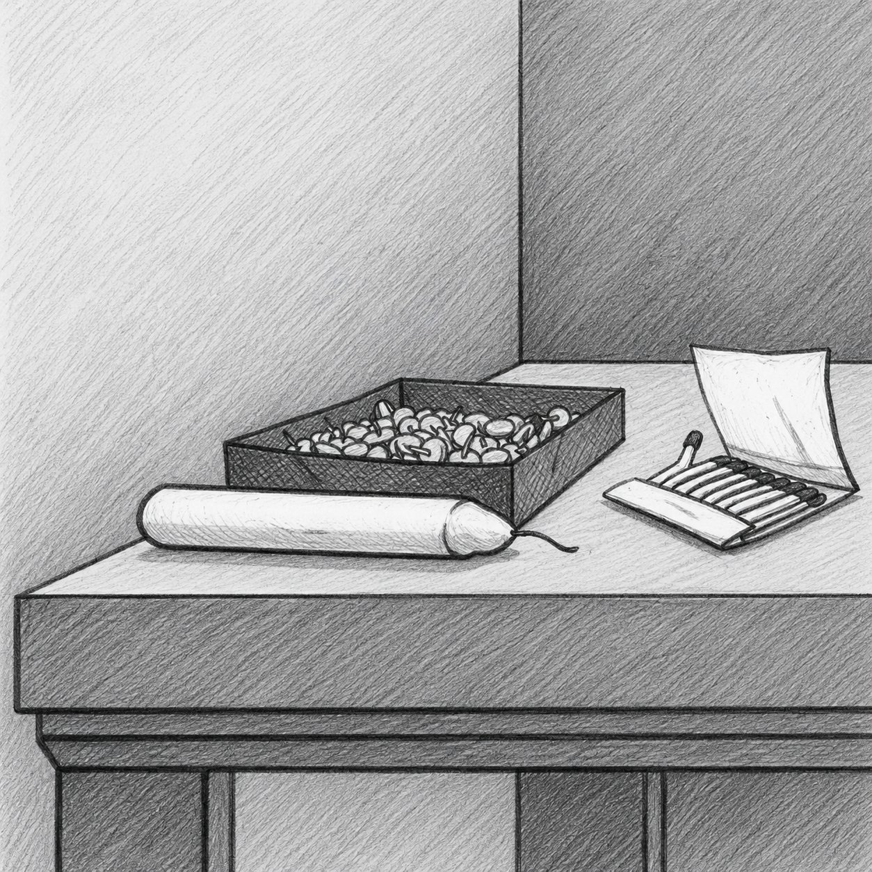
The Candle Problem
Fix the candle to the wall so it can burn without dripping wax on the table. You may use only what you see.

Slide 10
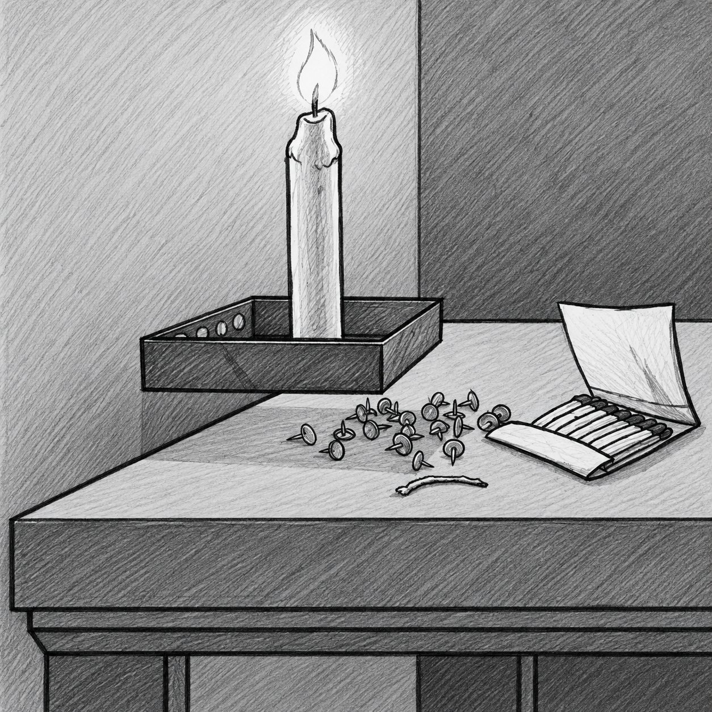

Slide 11
Resource: Anything Useful
What resources do you have?

Slide 12
Like the box with nails, sometimes resources are invisible at first

Slide 13
Your Resources Work Together
Time, Energy Attention
Relationship & Trust
Where do you spend them?
Help, Cooperation, Reputation
YOU
Health
Technology & AI
Physical & Mental
Tools, Judgement
What can you do with what you have?
Knowledge & Skills
Money
Learn, Practice, Apply
Use, Save, Invest, Donate

Slide 14
Resources are All Around You
Inside you - curiosity, health, attention, patience, perseverance, resilience, imagination, knowledge, skills
Around you - a library, internet access, tools, land, nature, school facilities
People - friends, parents, teachers, neighbours, community knowledge, trust
Life - experiences, mistakes, difficulties overcome, responsibilities, things I have already figured out
What other resources can you discover?

Slide 15
Having something is not the same as using it as a resource.
Learn to recognise it. Learn to use it well.
Ask: Is it helping you or holding you back?

Slide 16
Your Resource | When it Helps You | When it Holds You Back
Phone / Internet | Learning, Communication | Endless Scrolling, Misinformation
Friends | Support, Ideas, Encouragement | Peer Pressure, Bad Influence
Confidence | Willingness to try | Overconfidence, Not listening
Curiosity | Exploring, Questioning | Never finishing anything
Persistence | Staying with a difficult problem | Sticking with a wrong approach
Knowledge | Better Decisions | Thinking - I already know
Energy | Action, Learning | Restless, No direction
Trust | Easy to cooperate | Gullible, Indiscriminate trust
AI | Effective Tool | Dependence - AI will think for you
Money | Enabling Choices | Impulsive spending, Status

Slide 17
Every student already has valuable resources.
The skill is learning how to use them well.
What do
you have?
What can you do with them?
Who needs it? Usefulness
How can you
do it better?
Resources
Use them
Waste them!
You
Others
Create more value

Slide 18
Small actions can look unimportant today.
Repeated over months and years, they can become a large advantage (compounding).

Slide 19
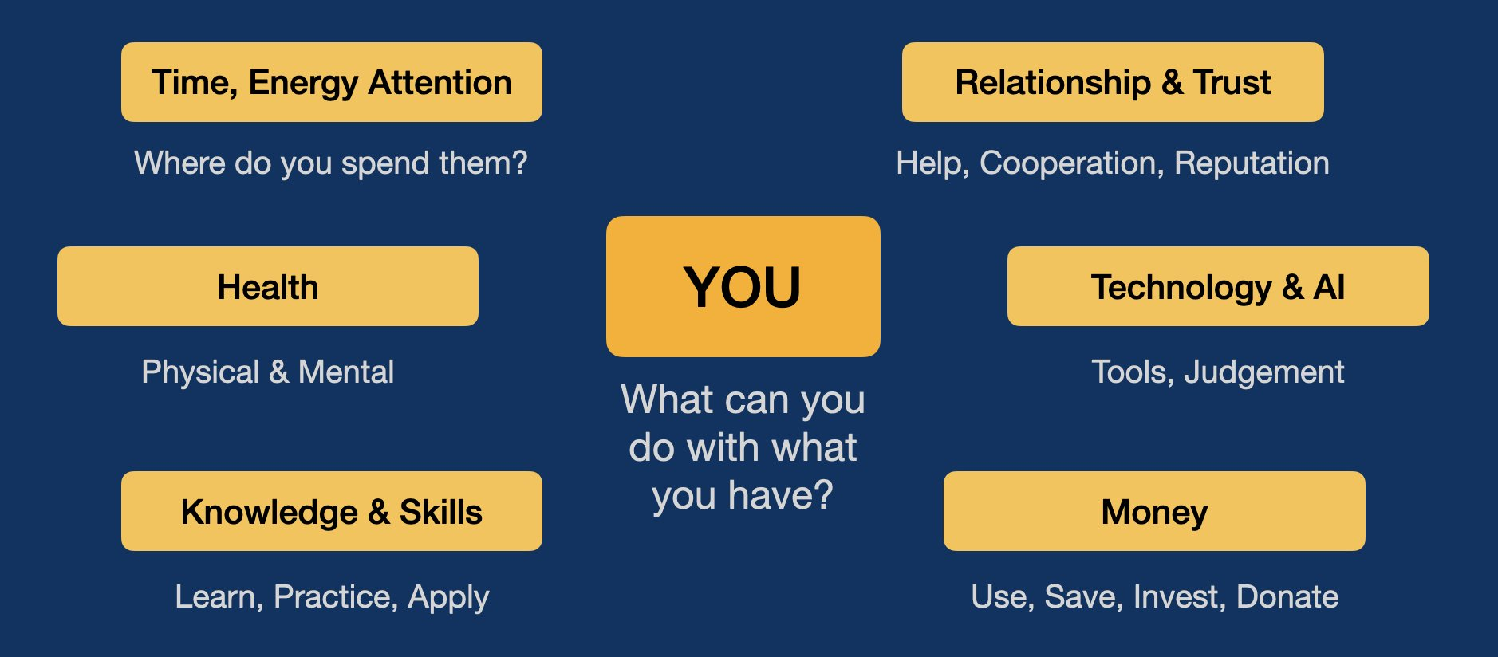
Start Early
- Magic of Compounding
Now or Later
- Delayed Gratification
Practice Daily
- Little and Often

Slide 20
Time

Slide 21
  You have 1 minute.
  Do something useful.

Slide 22
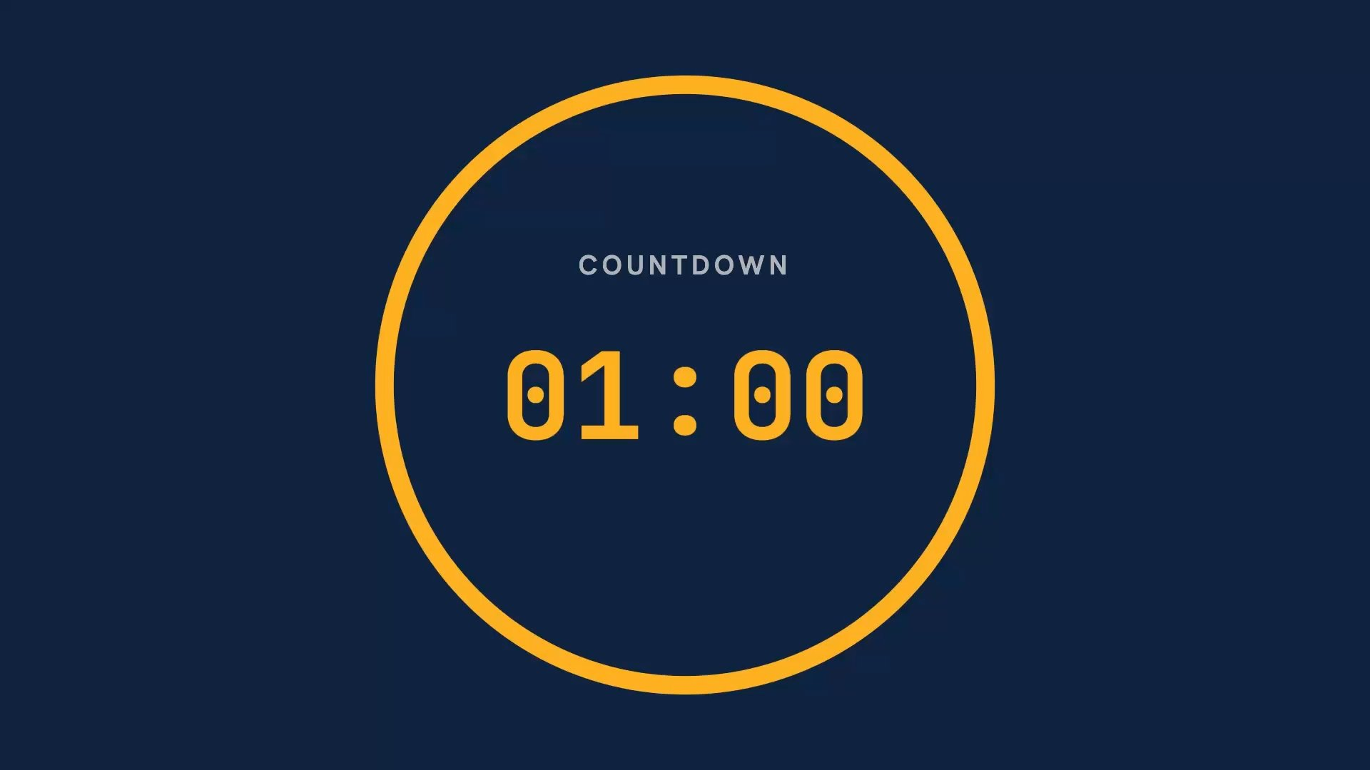

Slide 23
  What did you do?
Consume: enjoy, use something (YouTube short)
Better yourself: learn, practice, exercise (yoga, breathing)
Help Someone: your friend, your teacher (carry)
Create: make something new (sketch)
Exchange: create something that someone will value
Time is scarce. What matters is what you do with the time you have.

Slide 24
Attention

Slide 25
Marshmallow Activity

Slide 26
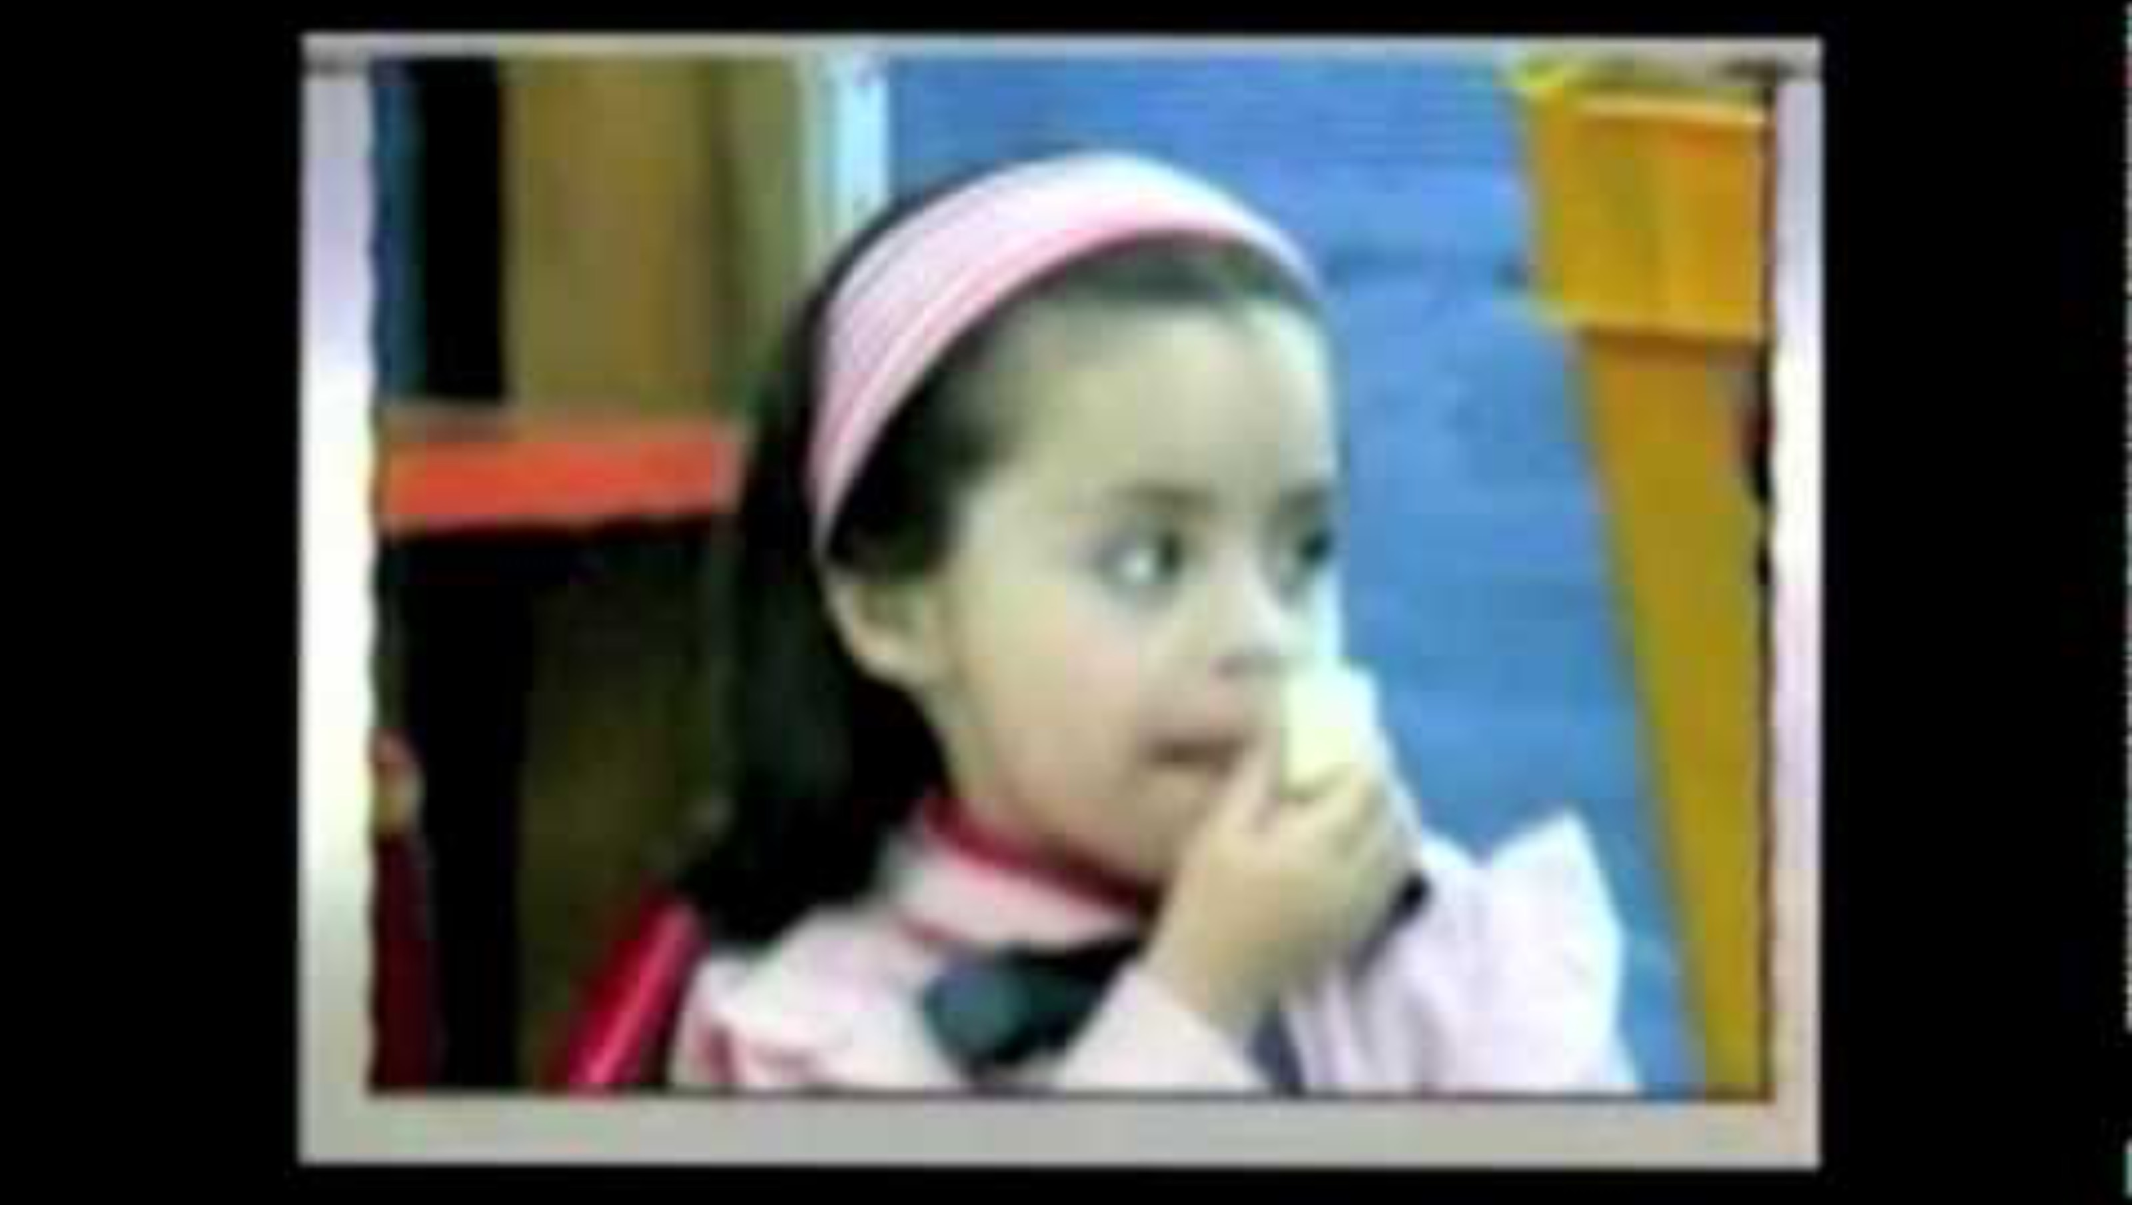
Marshmallow Video

Slide 27
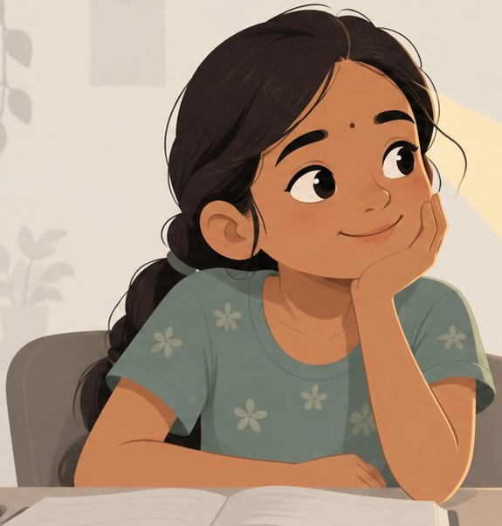
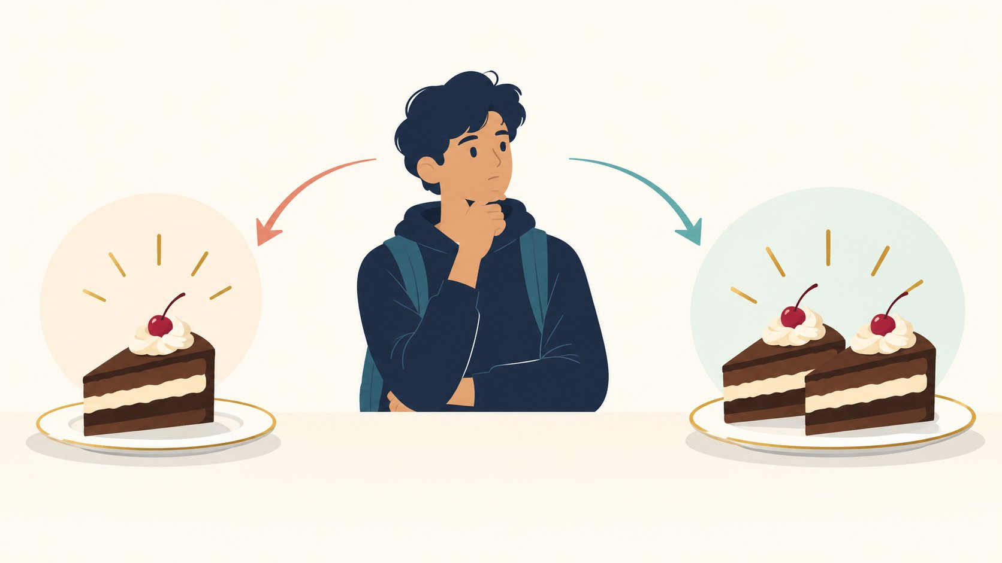
  Attention Mangement
  Now
  Later
Attention is a resource. Where you put it matters.
The more attention you give to the temptation, the harder it becomes to resist.
Good self-control often means changing what you pay attention to - not fighting temptation harder.

Slide 28
  Delayed Gratification
  Now
  Later
Today Me
Future Me
Scroll Instagram
Spend Money
Stay Up Late
Study
Save Money
Sleep on Time
Sometimes giving up something small now creates something better later.

Slide 29
  Small Choices Compound
  Now
  Later
10 minutes reading today looks trivial.
One healthy meal is insignificant.
10 minutes every day becomes knowledge.
Repeated choices affect health.
The reward for a good choice is often invisible today.

Slide 30
Energy

Slide 31
Time is given.
Your Energy determines how much you can do in same amount of time.

Slide 32
Think of a day when you got a lot done.
How had you slept the night before?
Time × Energy = what you actually get done

Slide 33
Your Body: nutrition, exercise, sleep
Your Mind: stress-free, calm, enthusiastic
Energy comes from

Slide 34
Nutrition, Exercise, Sleep
Physical Health

Slide 35
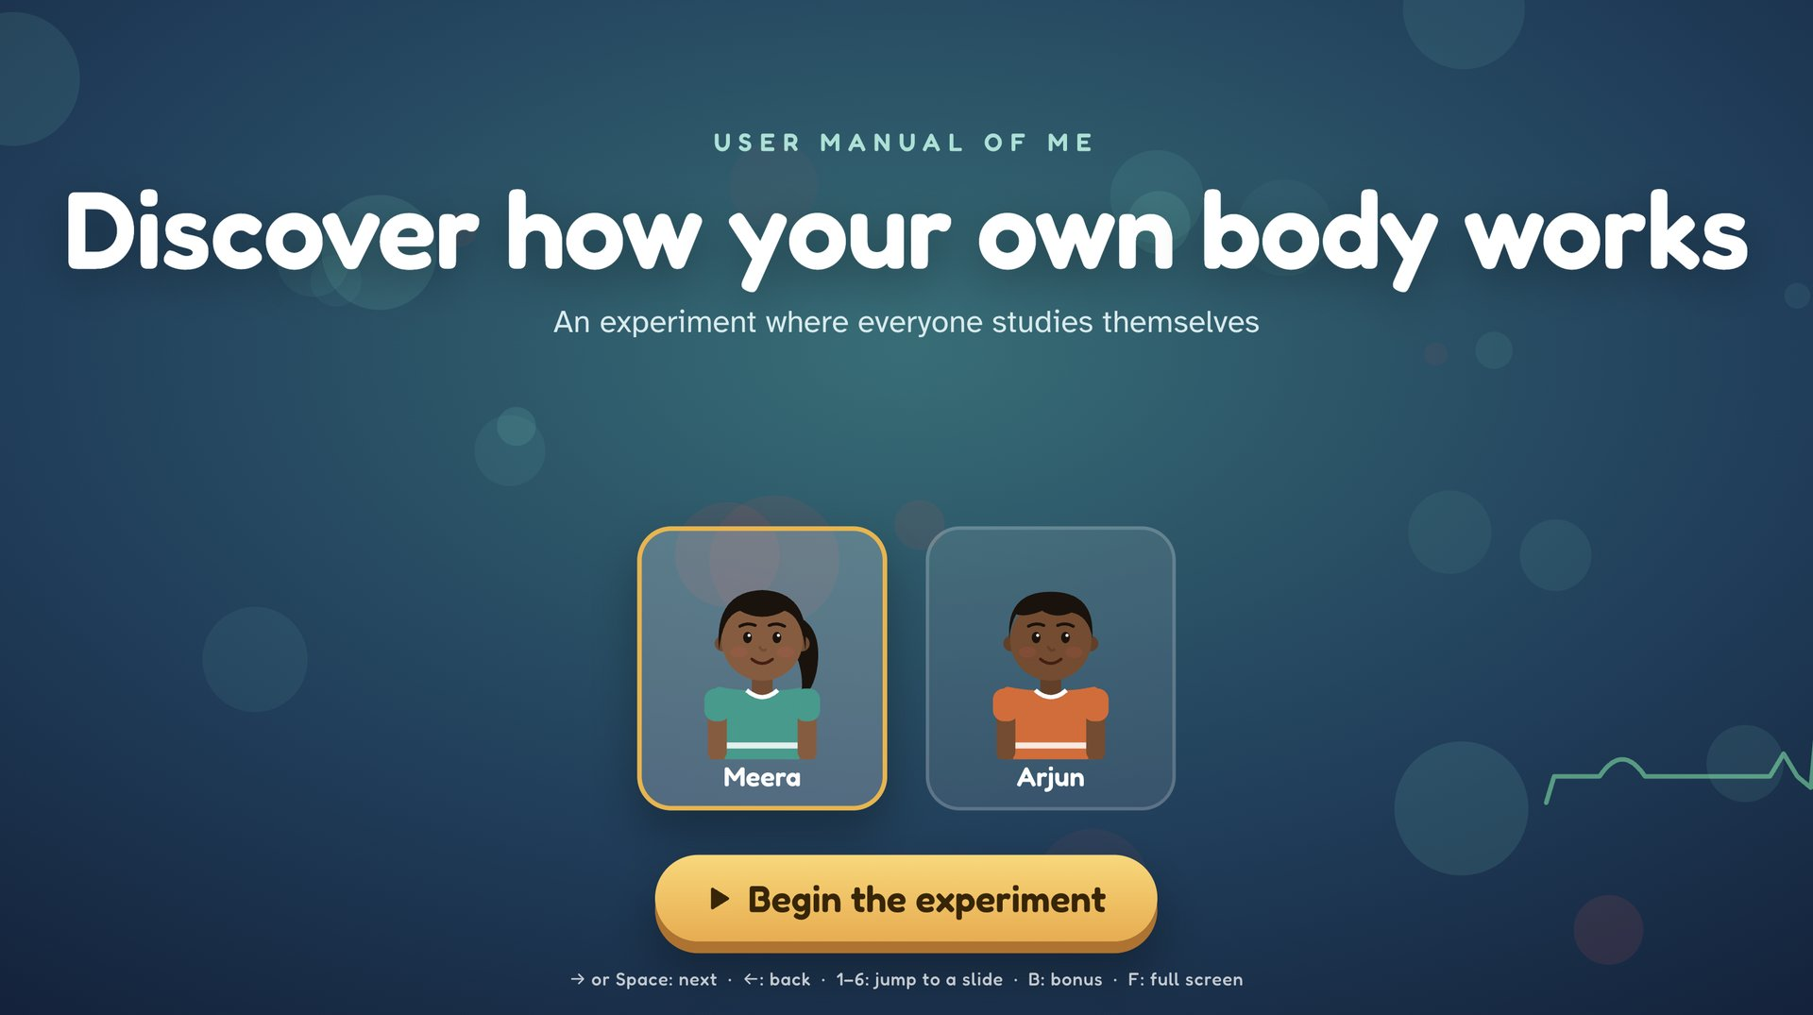
Click on the Slide to Launch Activity

Slide 36
Continuous Health Monitoring

Slide 37
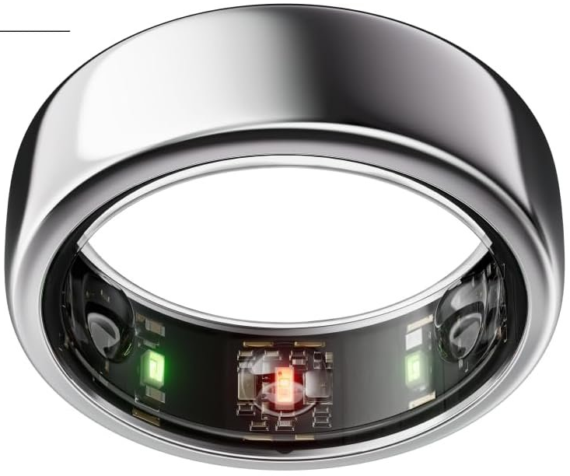
Sensors in Oura Ring
Infra Red: Invisible light through the skin to measure changes in blood volume to track Resting Heart Rate (RHR), Heart Rate Variability (HRV), Respiratory Rate
LED sensors: to track daytime heart rate, workout heart rate, and overnight Blood Oxygen Levels
Thermistors: temperature sensors that continuously measure Skin Temperature to detect early signs of sickness or track menstrual cycles.
3D Accelerometer: motion sensor that tracks physical steps, daily activities, workouts, and any tossing and turning during sleep.

Slide 38
Your Mind
Mental Wellbeing

Slide 39
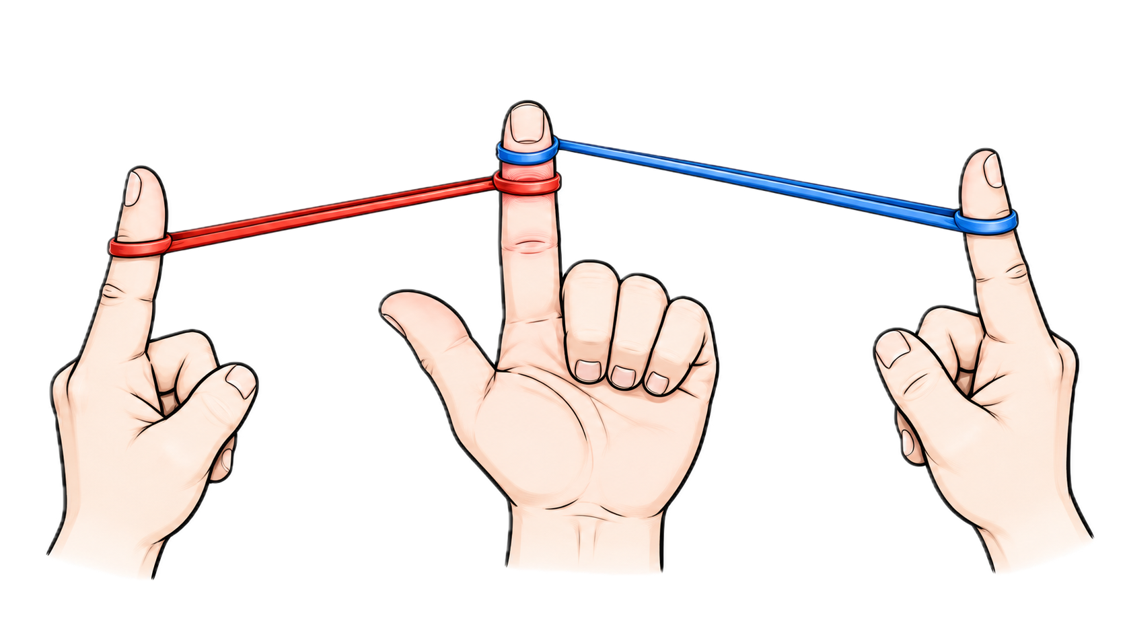
Rubber Band Activity

Slide 40
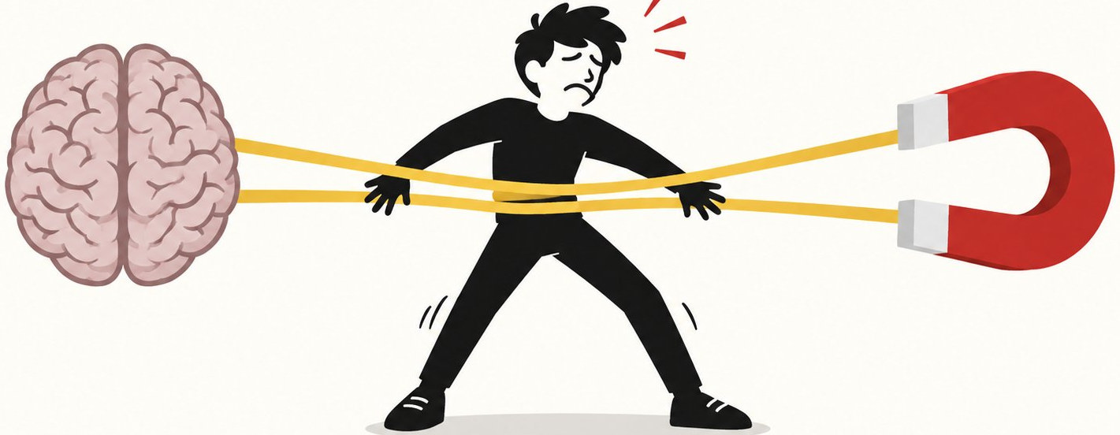
  Inner Conflict
  Creative Tension
What Holds You Back
What You Want
  Fear of Failure
  Fear of Ridicule
  Lack of Energy
  Lack of Clarity
  Negative Beliefs
  Goal gives Focus
  Goal gives Energy
  Useful Tension
Your Current Reality
  Source: The Fifth Discipline, Peter Senge

Slide 41
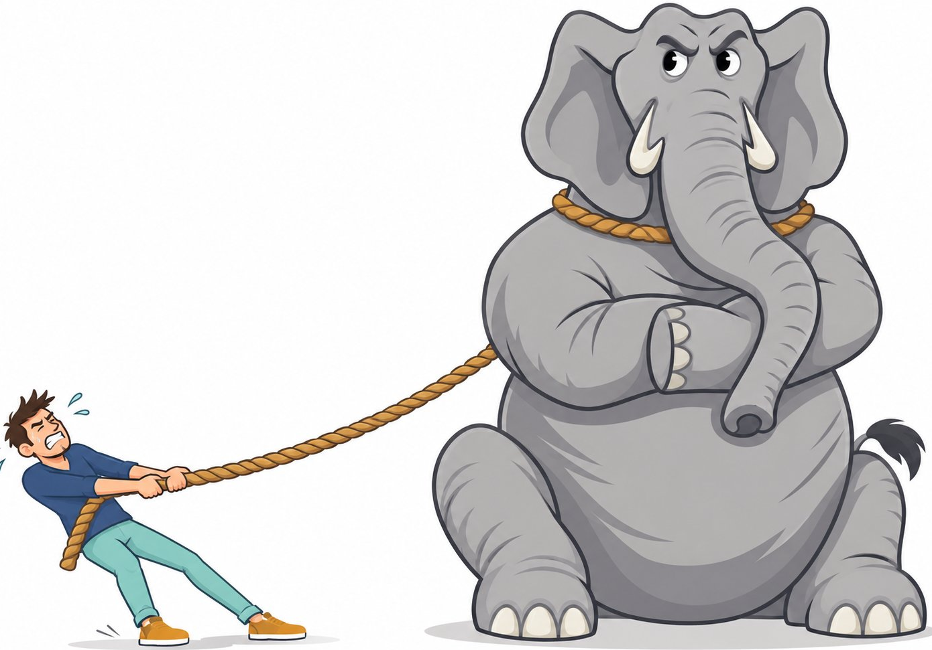
  Your Thinking and Emotions Need to Align
  Rationality
  Thinking, Planning
  Sets the goal
  Knows where we want to go
  Understands what we should do
  Emotions
  Fear
  Desire
  Self-Belief
  Habits
  Motivation
Elephant
Rider
  Rider–Elephant metaphor adapted from Switch, Chip & Dan Heath

Slide 42
  The Rider may keep saying go towards the goal,
  but if the Elephant is frightened, doubtful or resisting, you will not move
Elephant
Rider
  Rider–Elephant metaphor adapted from Switch, Chip & Dan Heath

Slide 43
  How to Move the Elephant
  Recognise what is holding you back: fear of failure / ridicule, peer pressure, negative beliefs
  Give the Elephant a reason to move: make the goal emotionally meaningful - I want to prove to myself I can do it, I want to help my family
  Take small steps
  Quick Wins
  Build Habits
  Shape the Environment
  Use Emotions Positively: curiosity, excitement, hope

Slide 44
Automatic vs Deliberate Thinking

Slide 45
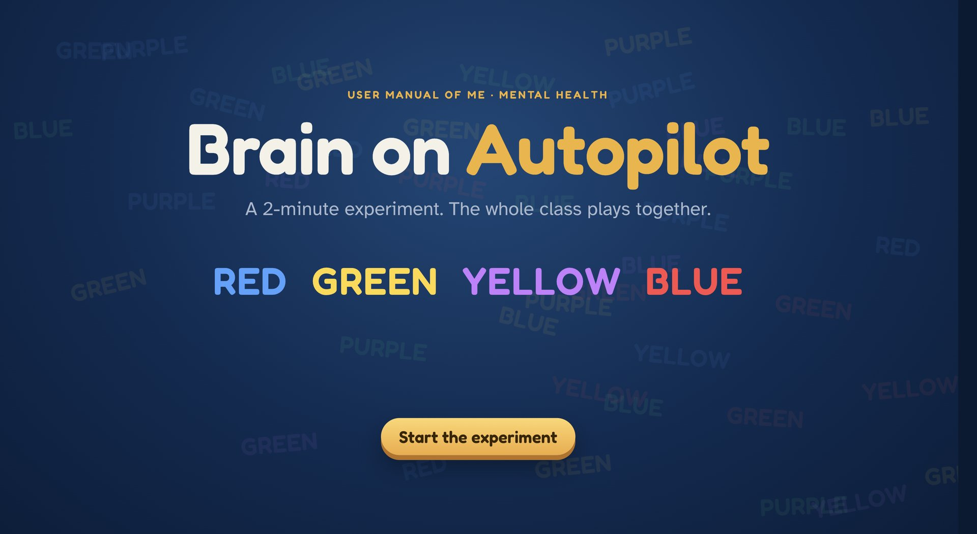
Click Here to Start Activity

Slide 46
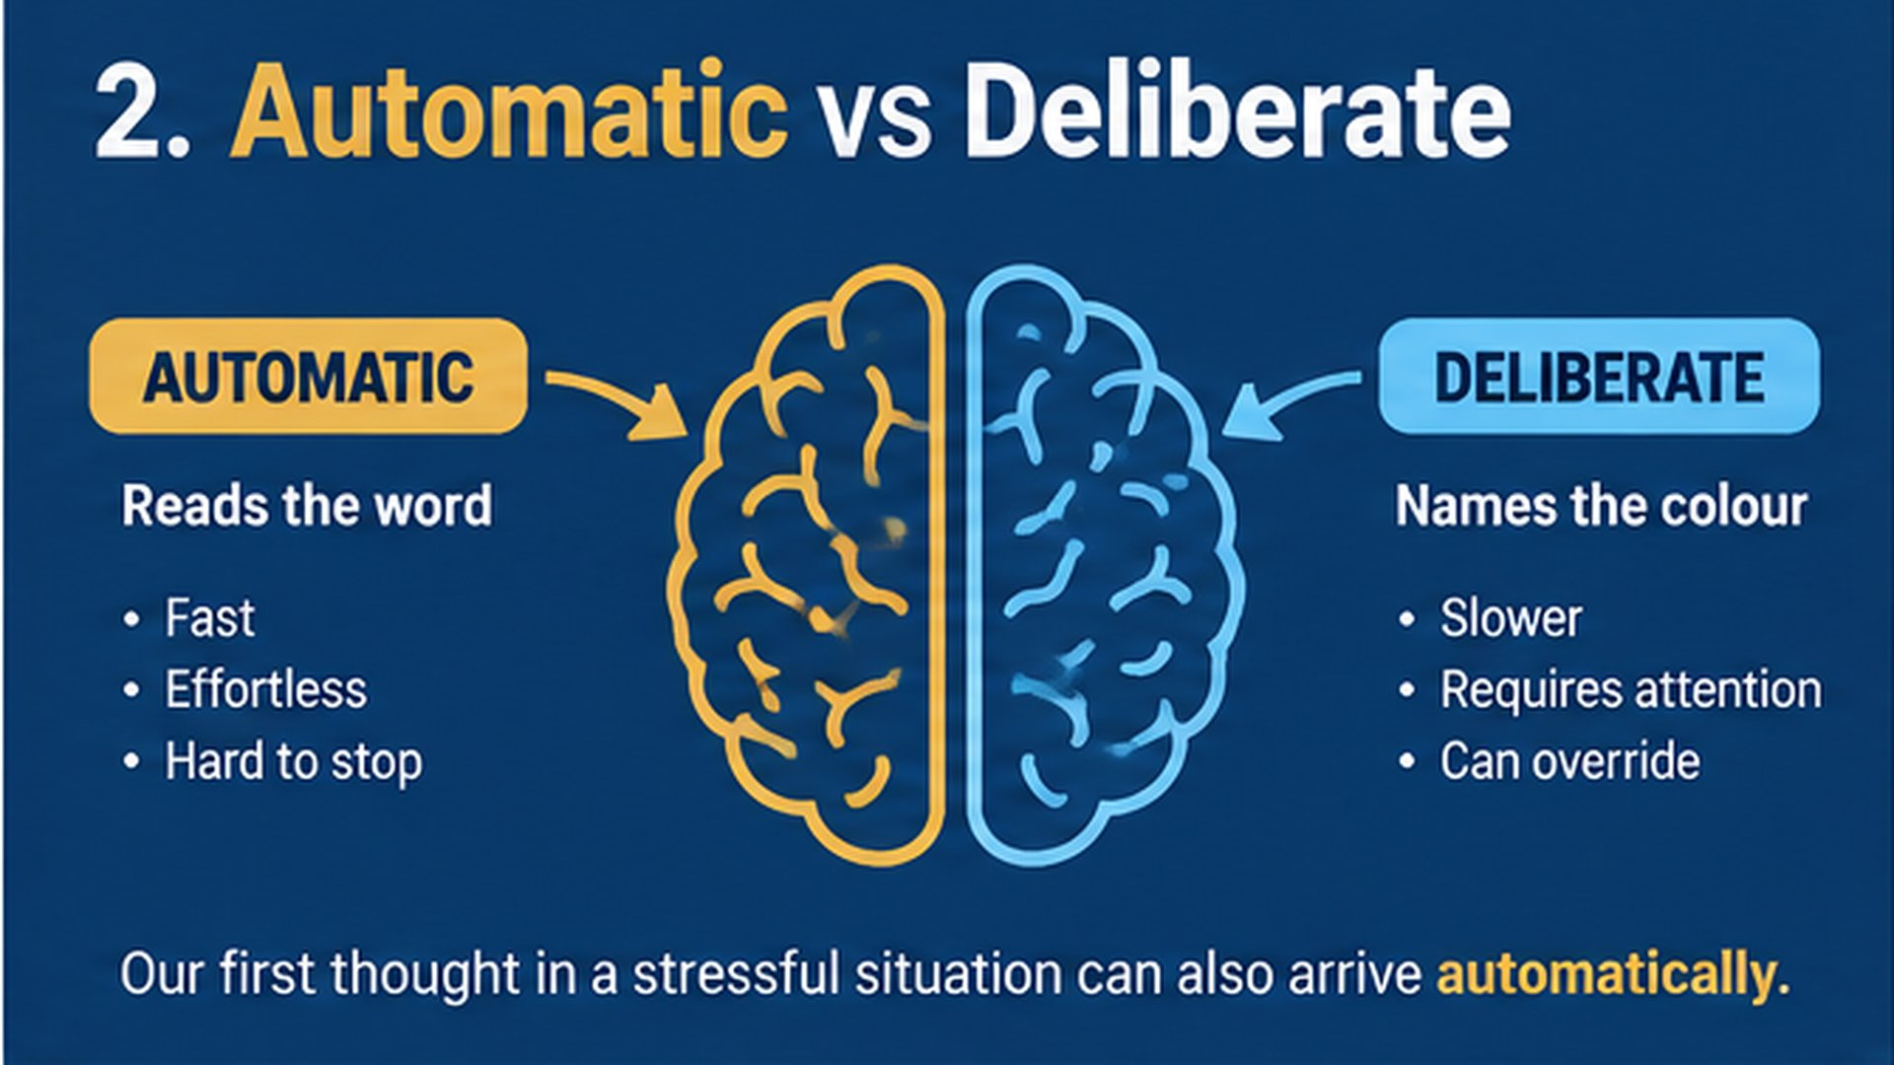

Slide 47
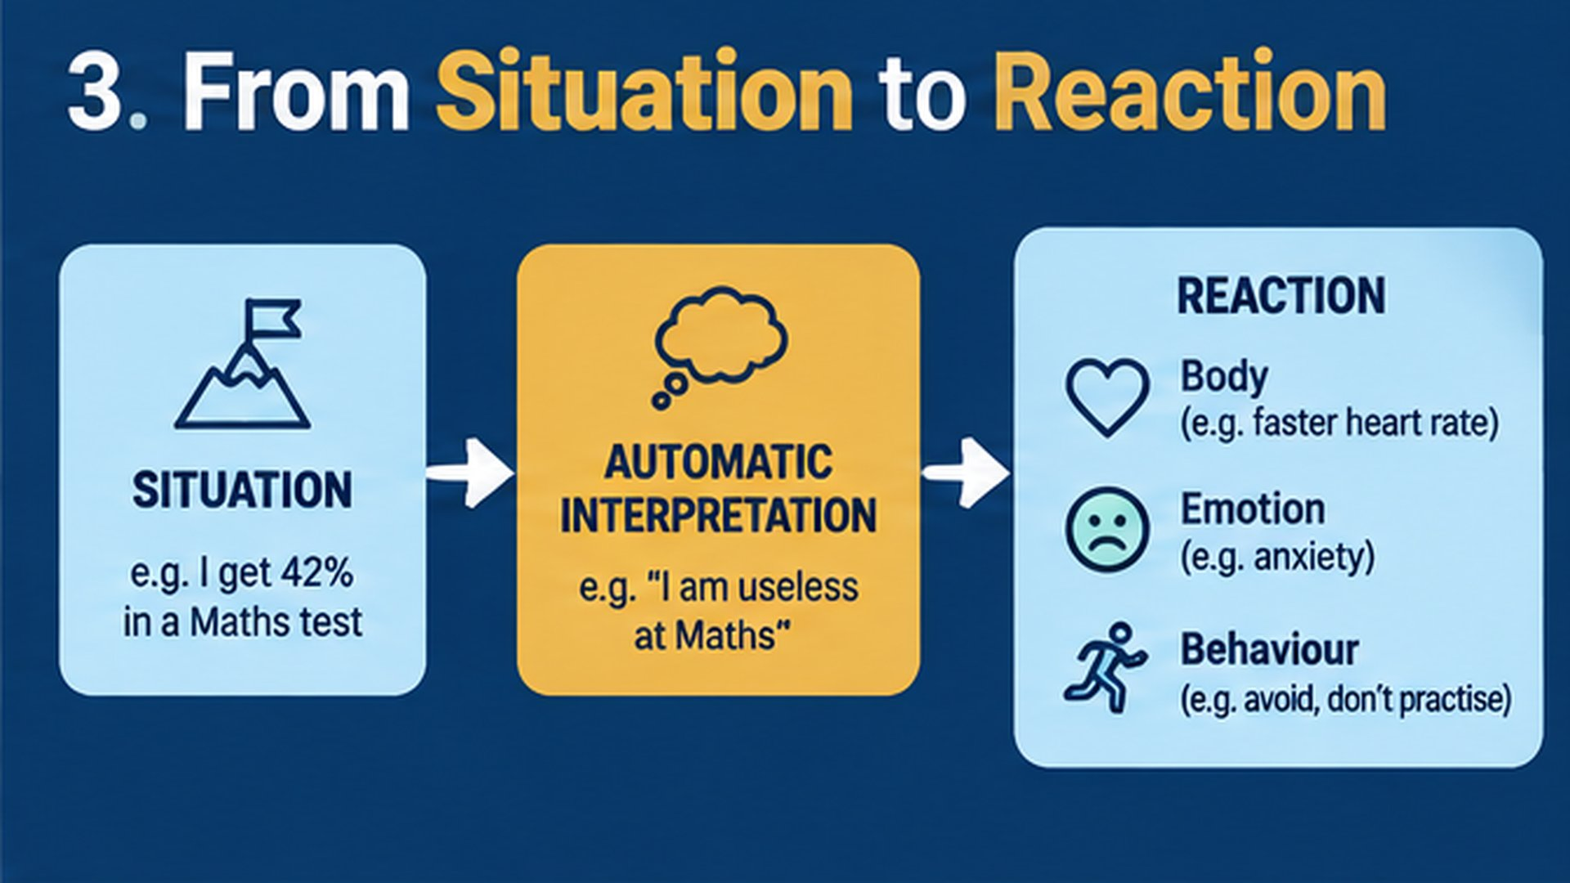

Slide 48
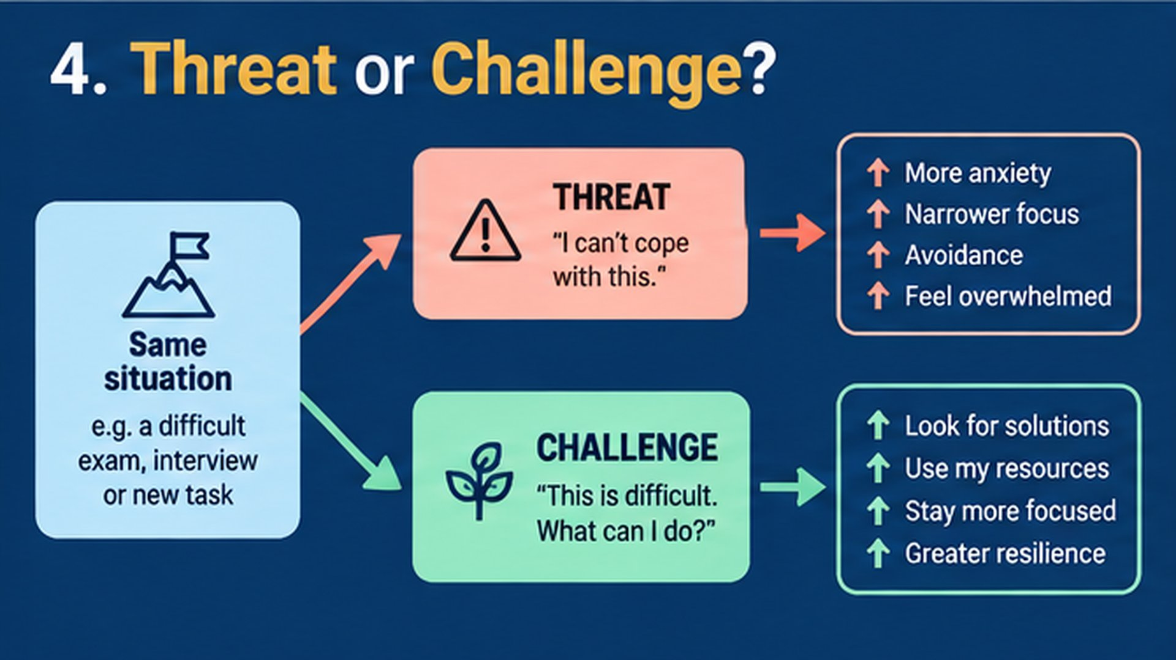

Slide 49
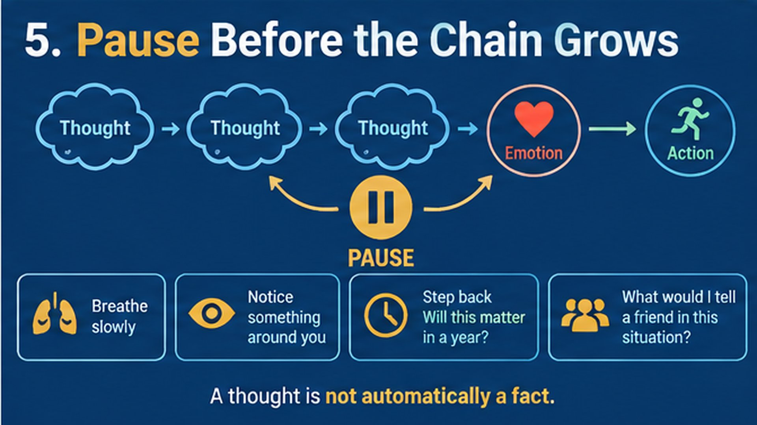

Slide 50
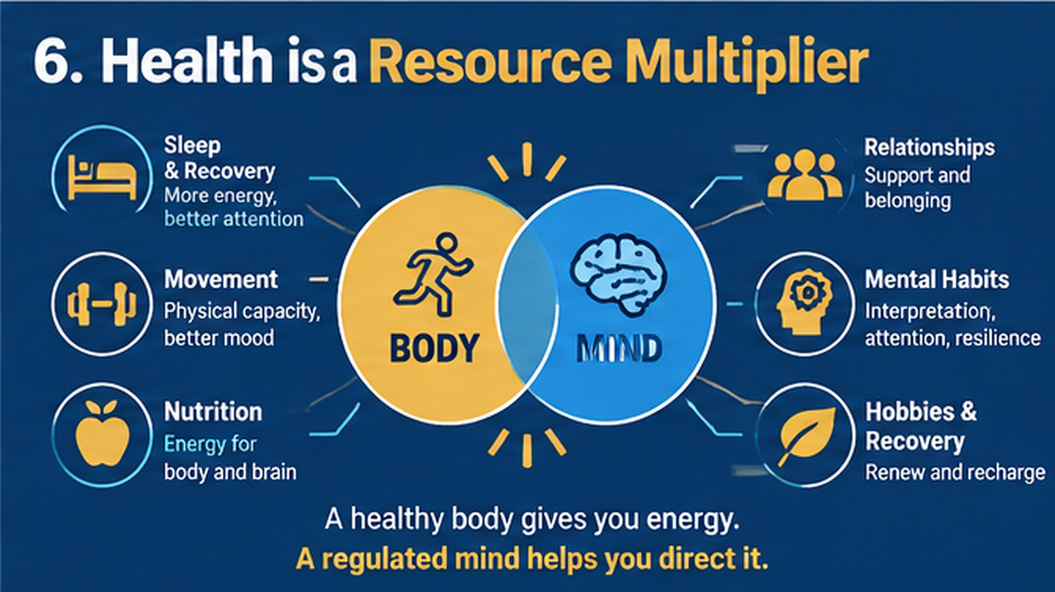

Slide 51
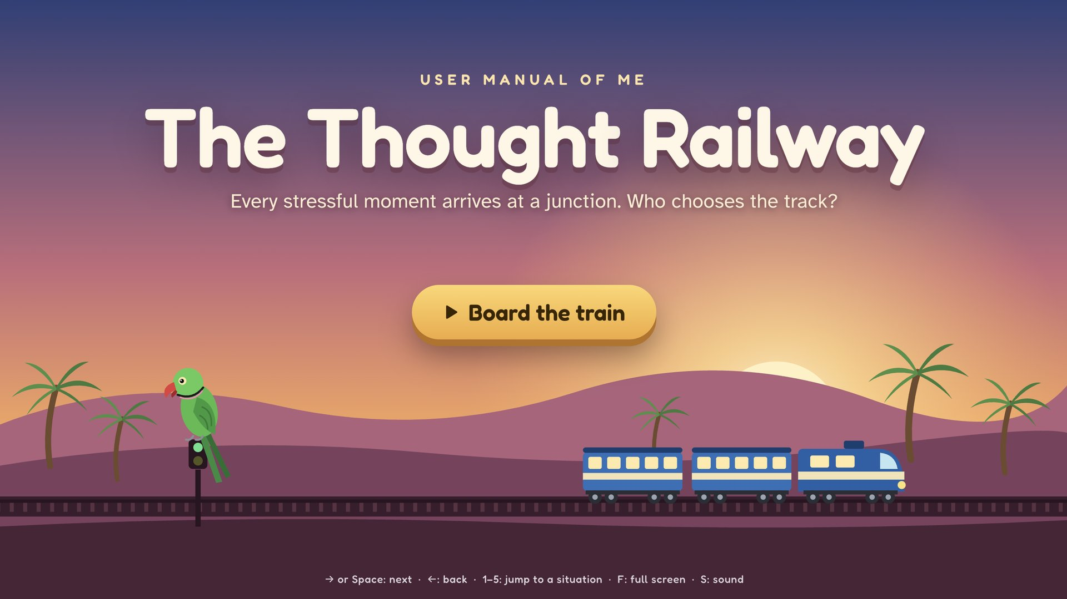
Click on the Slide to Launch Activity

Slide 52
Trust

Slide 53
  Trust lets you do things you can't do alone.
When people trust you:
A teacher gives you responsibility, like leading the Manak Awards
A friend lends you their notes
A shopkeeper gives you credit until tomorrow
A team chooses you for their project
You can't buy trust. You can only earn it.

Slide 54
  Trust Compounds
Return the notes on time → a friend lends you a book
Finish a small task → the teacher gives you a bigger one
Be fair once → people want to work with you again

Slide 55
But trust wisely. Check before you believe.
Trust people step by step, based on what they do, not what they say.

Slide 56
  How Trust is Lost
Break a promise, even a small one
Lie, or hide a mistake
Share someone's secret
Forward a rumour without checking it
Keep all the mangoes for yourself!
Trust grows slowly. It breaks in a moment.

Slide 57
Repairing trust is possible: admit it, say sorry, keep the next promise.
But regaining trust takes much longer than breaking it.

Slide 58
Who trusts you today that didn't trust you a year ago?
What did you do to earn it?

Slide 59
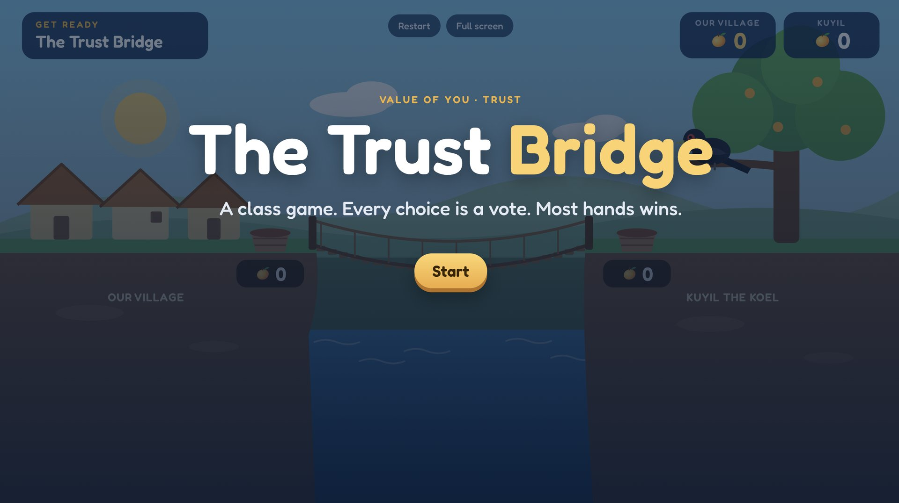
Click on the Slide to Launch Activity

Slide 60
Knowledge & Skills

Slide 61
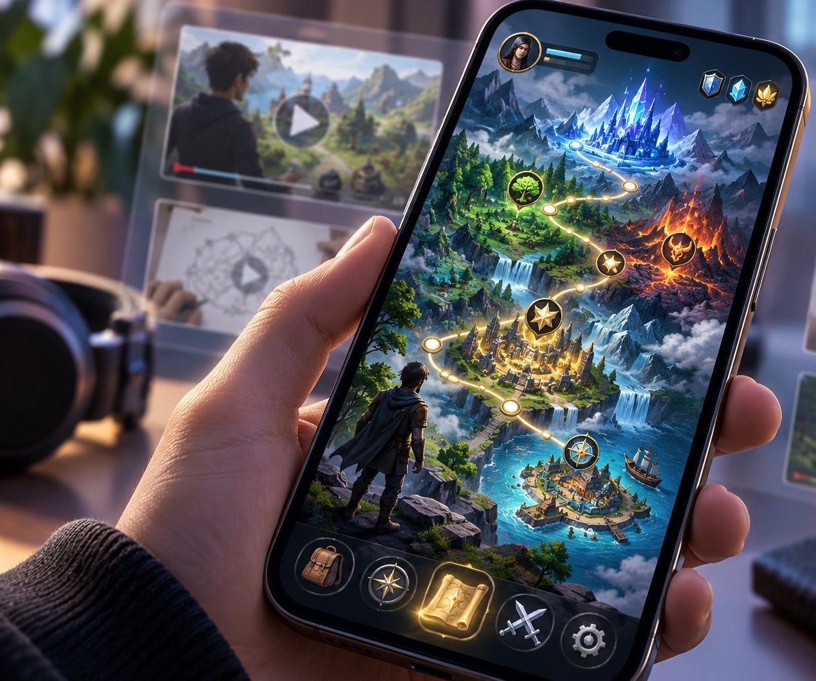
Can you learn a complex game on your own?

Slide 62
  A student learns because a syllabus, teacher and examination structure the learning.
  A learner yearns to learns, experiments, tolerates mistakes, accepts failures, and becomes better at learning.

Slide 63

Make Learning Fun and Interesting for Yourself

Slide 64
Knowledge & Skills
Making Learning Fun with AI

Slide 65
  Make Learning Fun using AI
Create a song that helps young students remember the multiplication table of 13
Convert a topic of study into a game or a learning mission

Slide 66

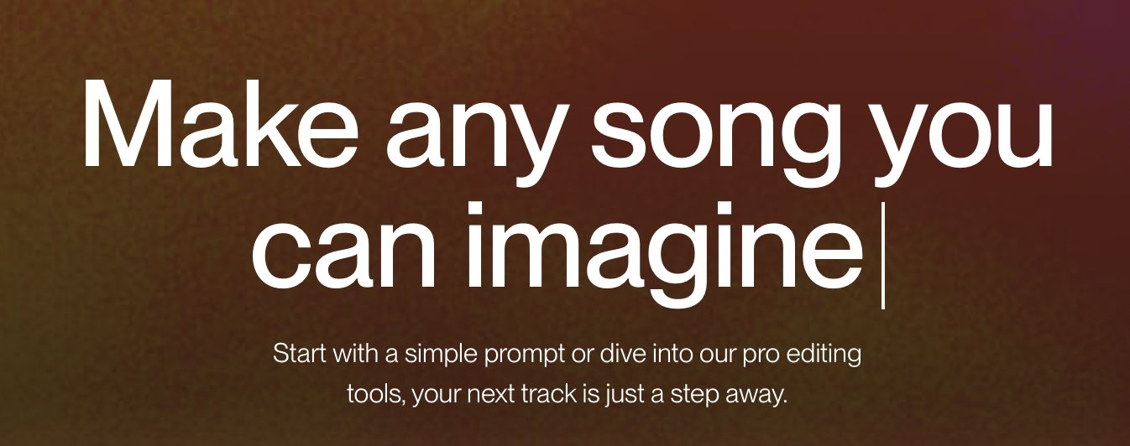
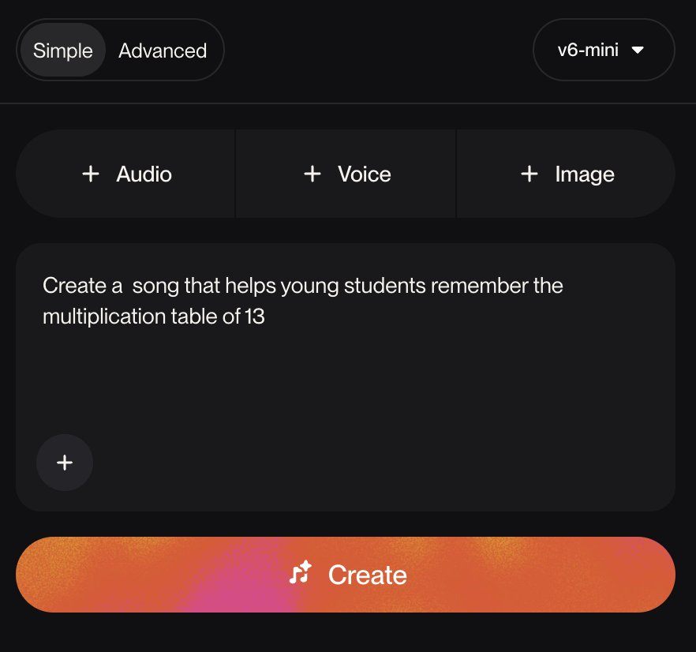
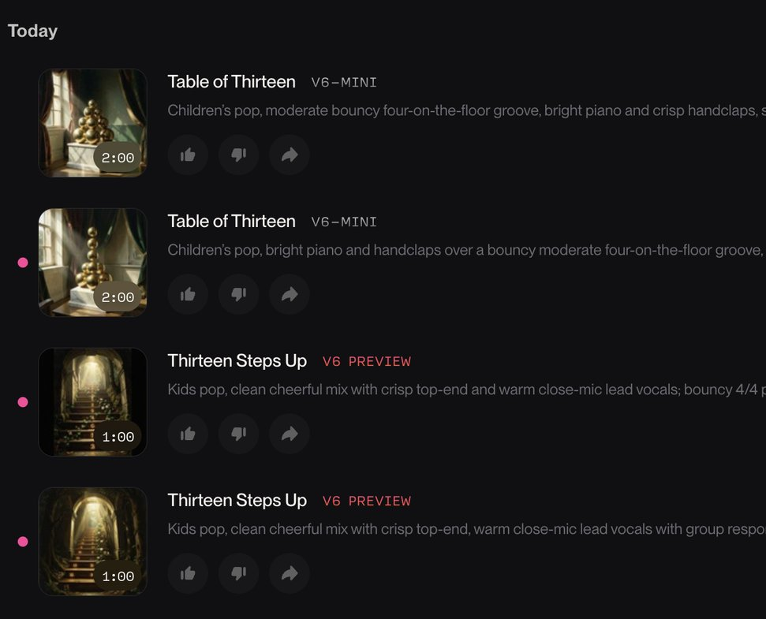
Periodic Table Song in Tamil
13 Times Table Song in Tamil

Slide 67
  Prompt to AI
  Create a visual, with fun illustrations, to explain the process of photosynthesis to a 8th grader

Slide 68
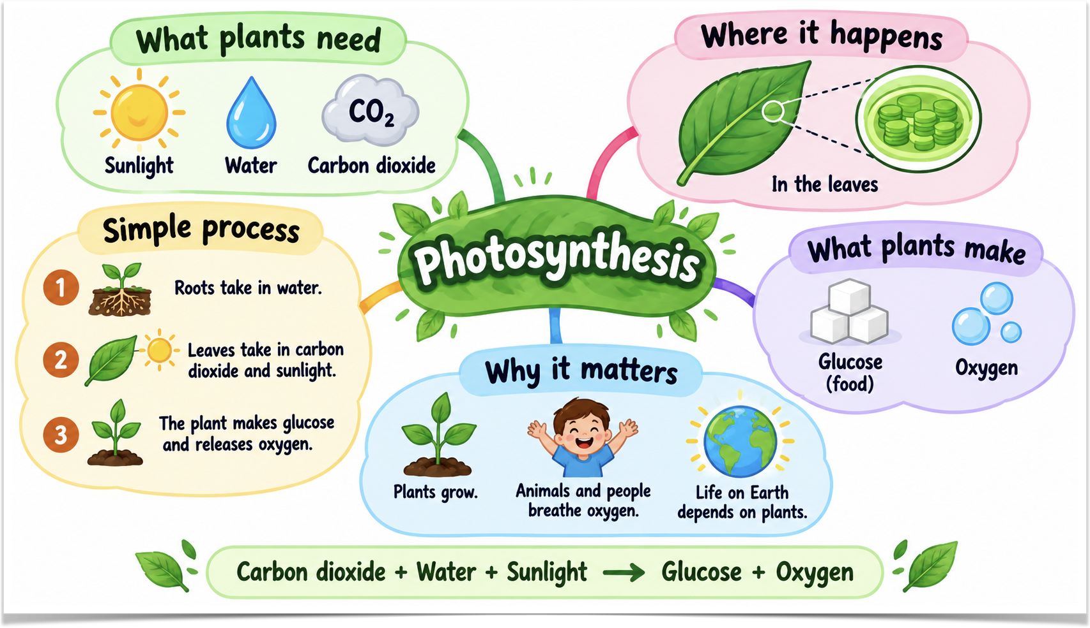

Slide 69
  Use AI to Make Learning Fun for Yourself
  Explain this visually
  Turn it into a cricket problem
  Don't tell me the answer; give me a hint
  Make me solve a mystery using this concept
  Tell me where my reasoning went wrong
  Increase the difficulty

Slide 70
  Prompt to AI
  Create an illustrated quiz on photosynthesis that students can use for revision

Slide 71
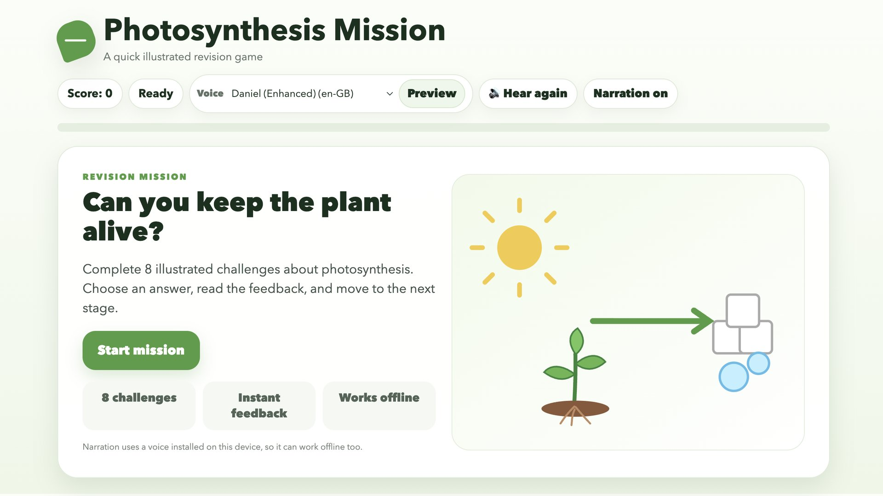
Click on the Slide to Launch Activity

Slide 72
  Your ability to learn is a resource.
  More importantly, it is a resource that can create new resources.
Learning to Learn is a Resource Multiplier

Slide 73
Think of something nobody taught you but you became quite good at. How did you learn it?
How did you become good at cricket?
Did you practice?
Did you reflect on your performance?
Did you work on your weaknesses?
Did you enjoy getting slightly better?
Your Previous Successes are Resources Too

Slide 74
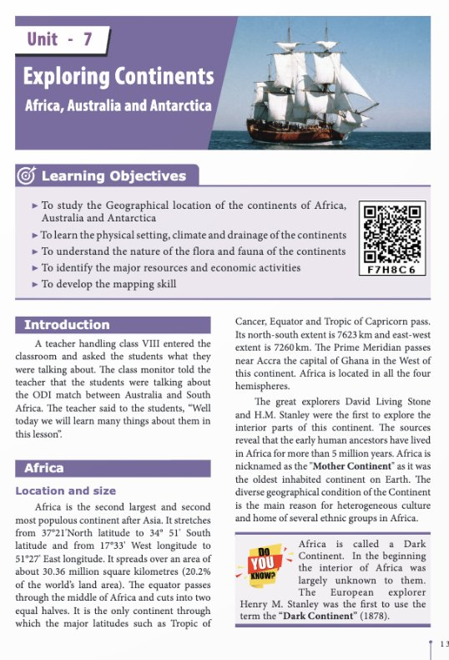
  Prompt to AI
  Convert class 8 Exploring Continents chapter into a simple game

Slide 75
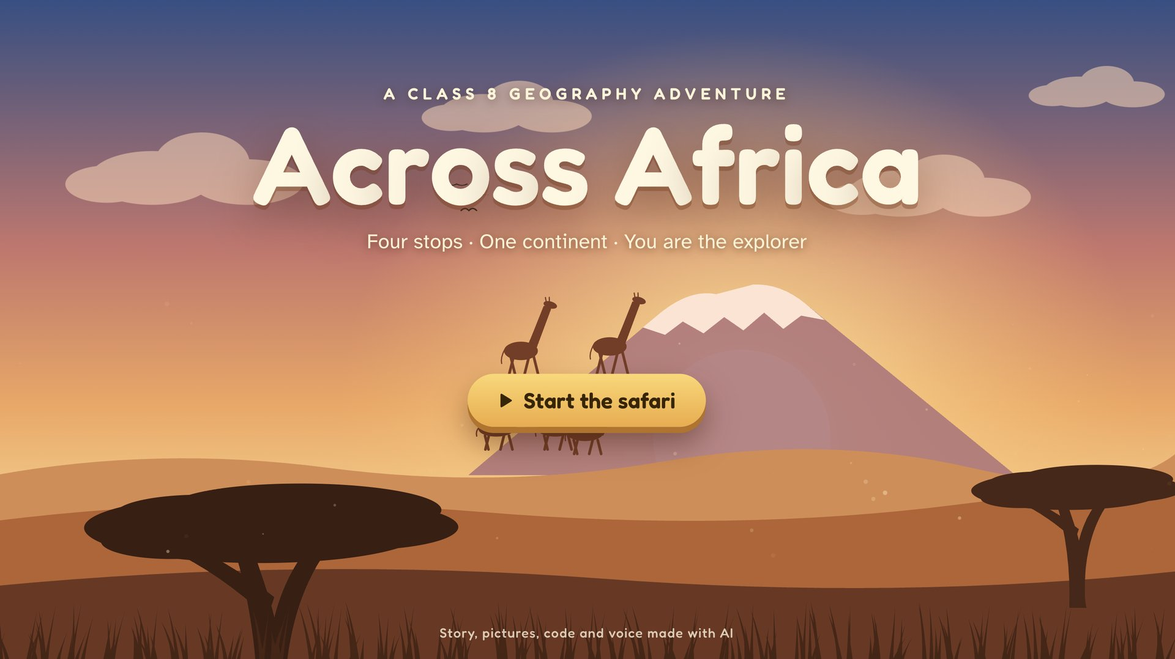
Click on the Slide to Launch Activity

Slide 76
Knowledge & Skills
Learning Activities with AI

Slide 77
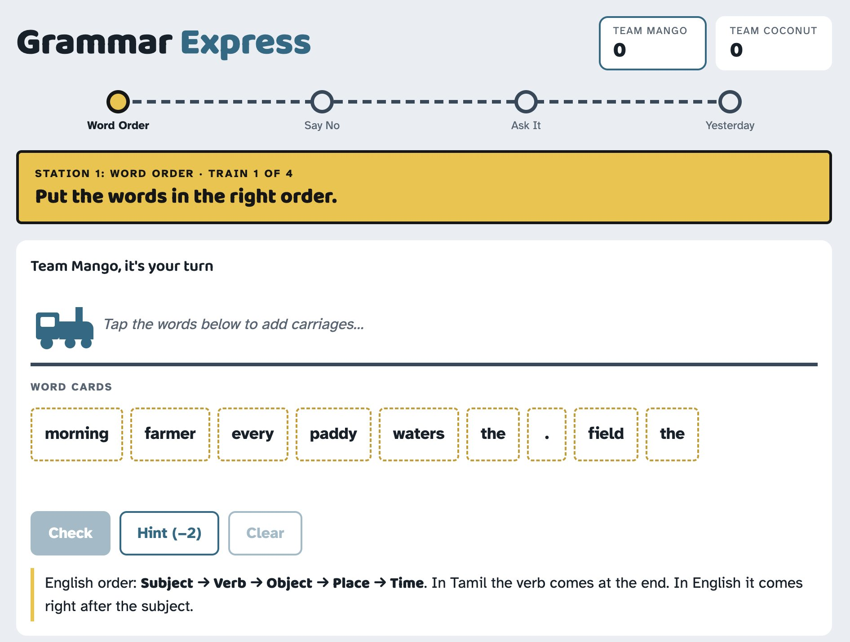
Grammar Express

Slide 78
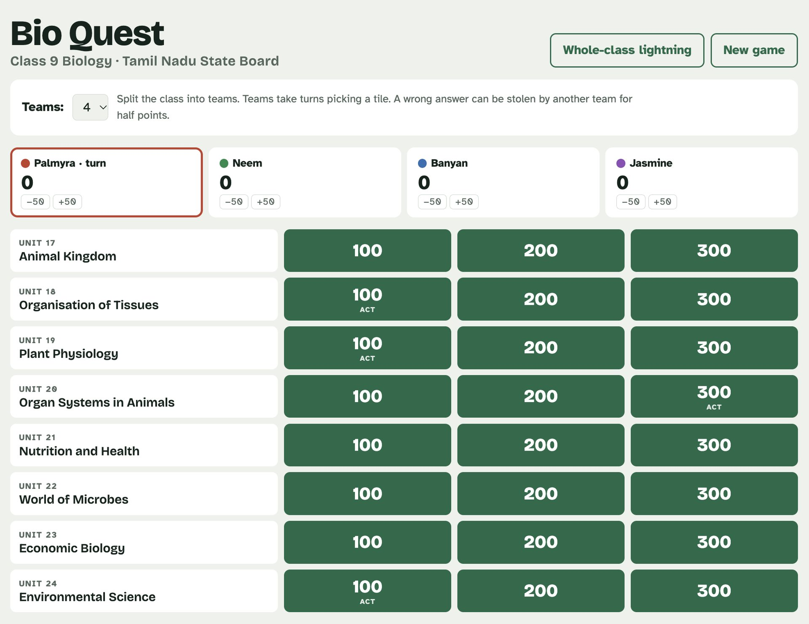
BioQuest

Slide 79
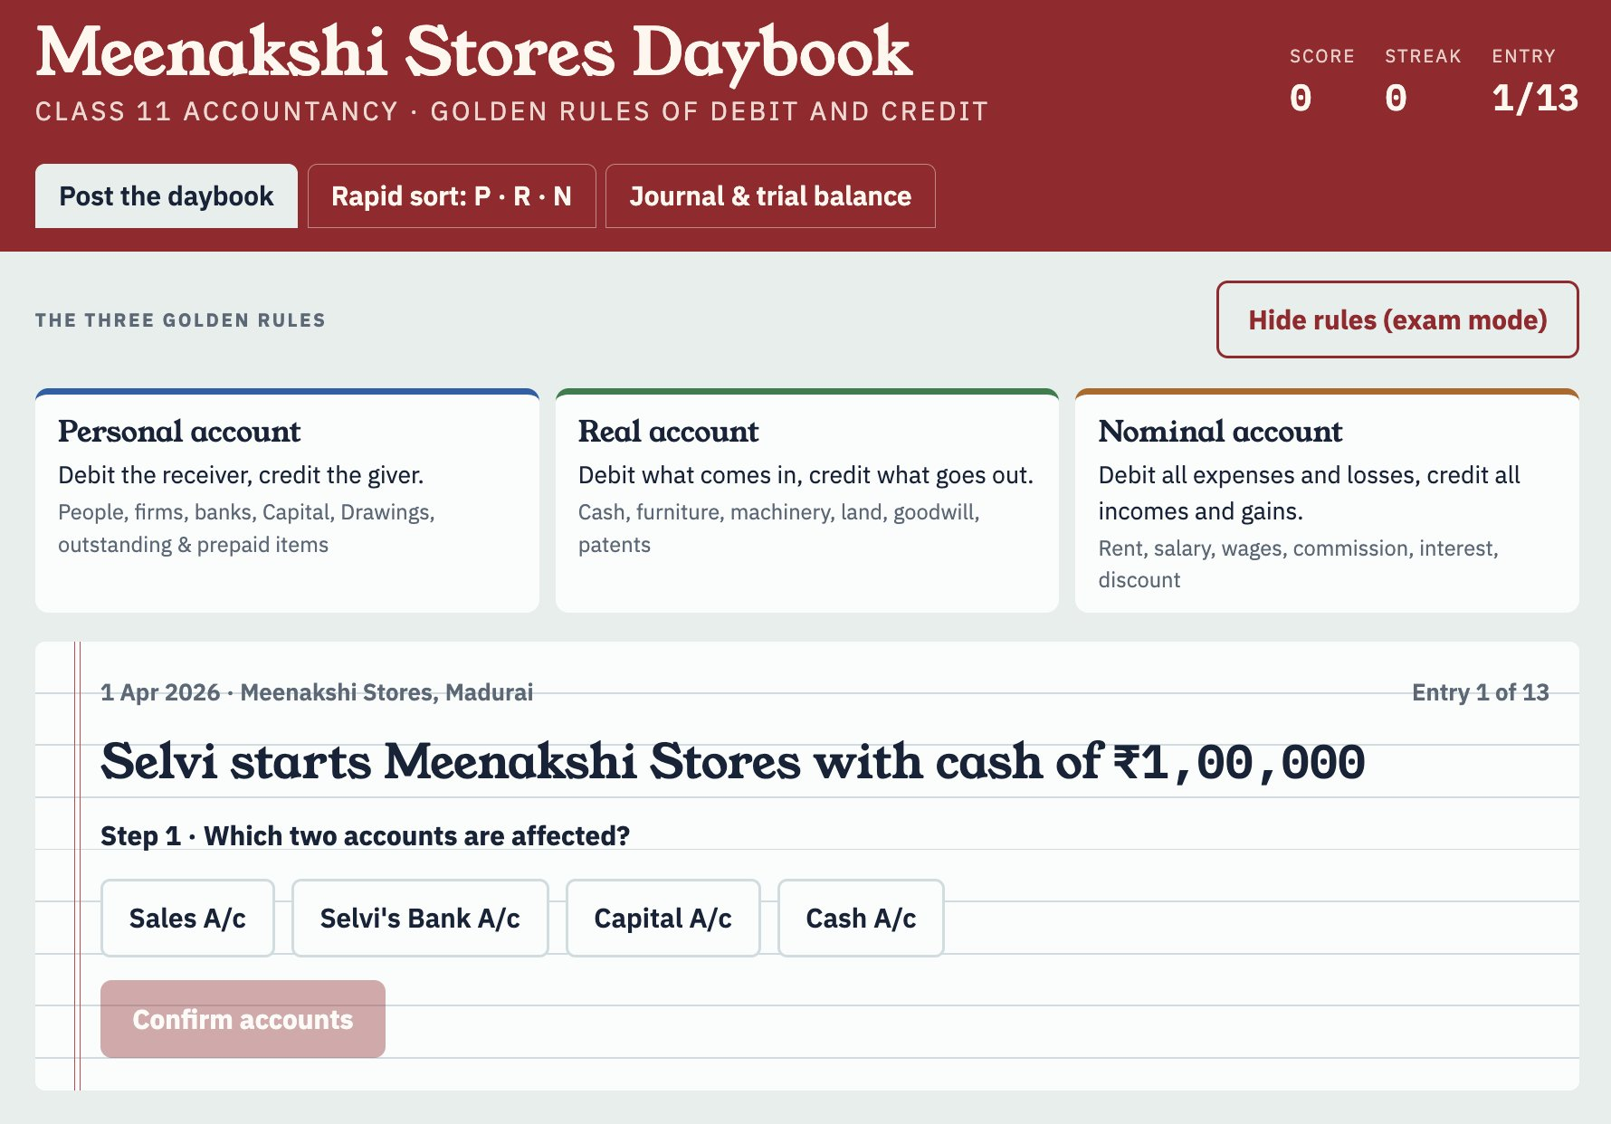
Accountancy Exercise

Slide 80
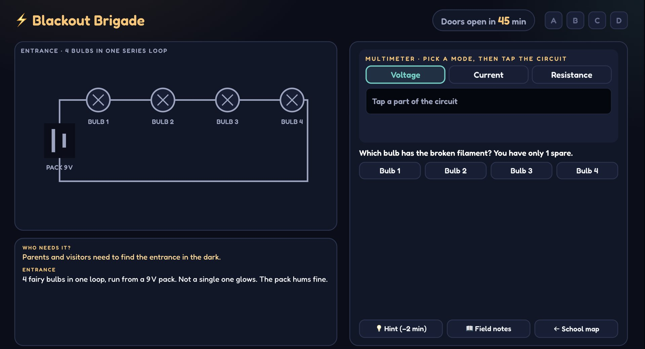
Circuits Activity

Slide 81
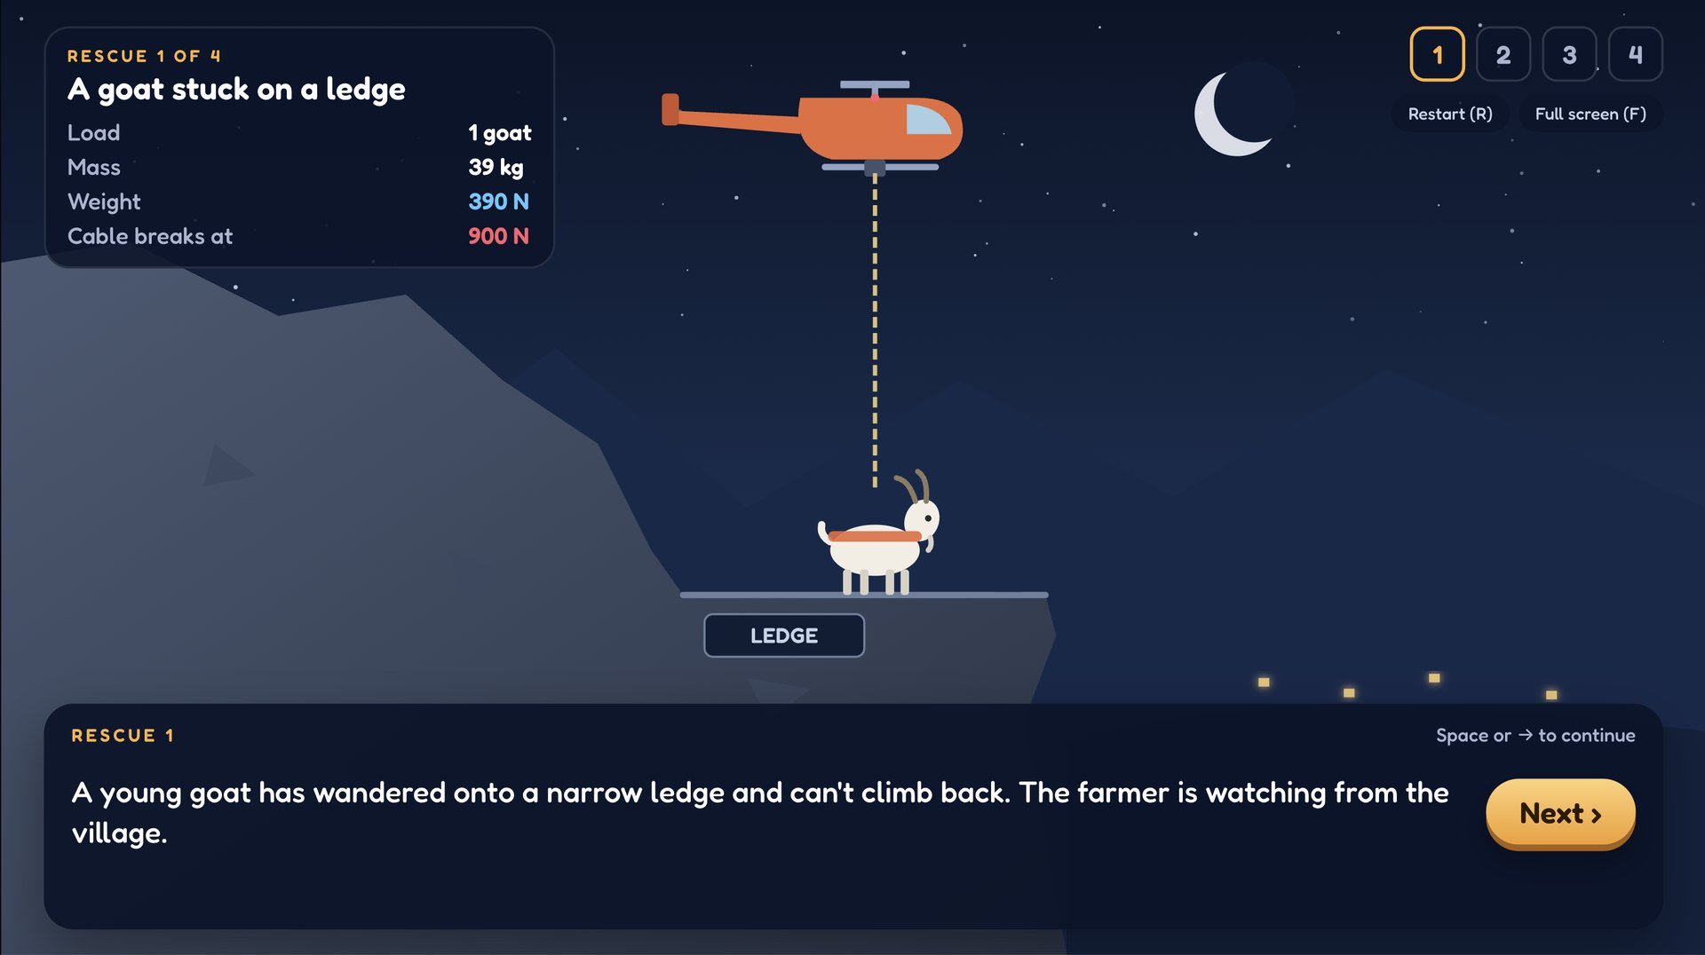
Physics Activity

Slide 82
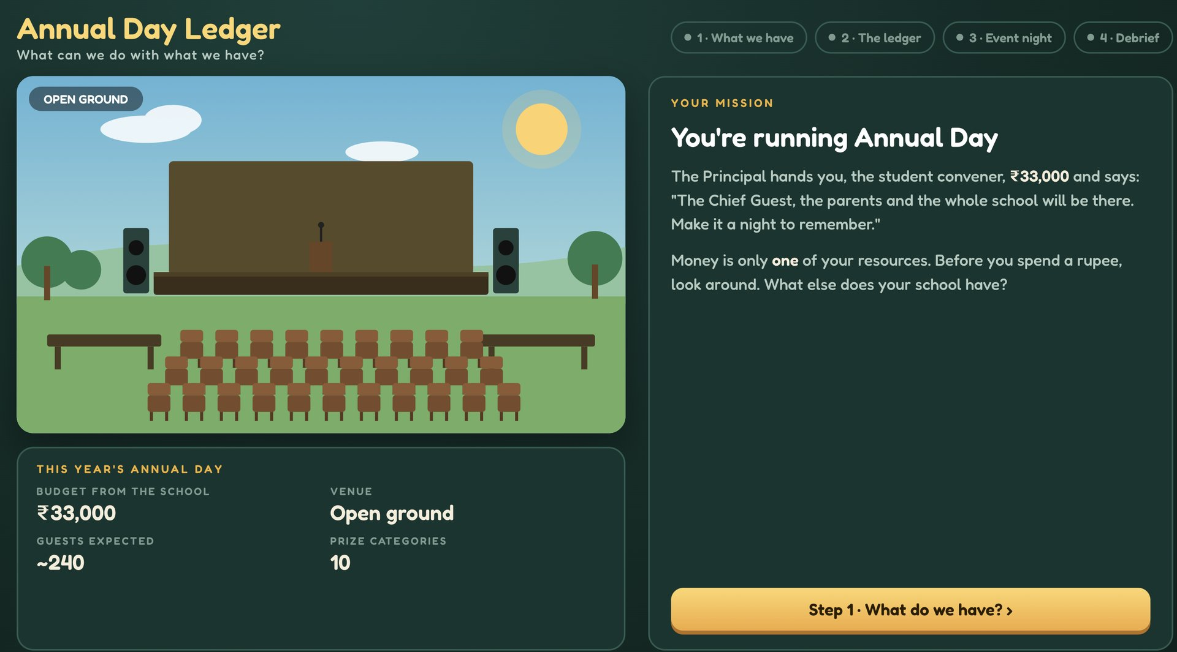
Budget Activity

Slide 83
Knowledge & Skills
Text-to-Video AI

Slide 84
Write a prompt in English (or in other languages) explaining what you want in the video/scene.
“A young school boy in rural Tamil Nadu, riding a bicycle down a red dirt road, when suddenly the bicycle grows wings and lifts off into the clouds.”

Slide 85
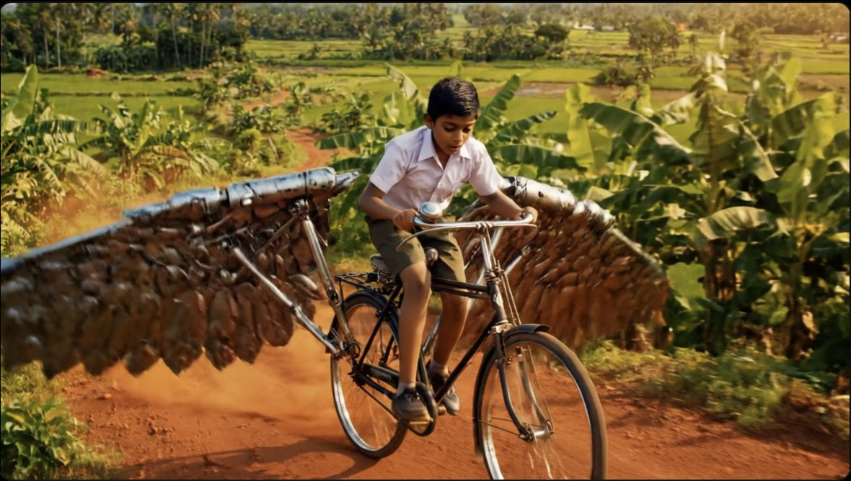
A Bicycle Grows Wings

Slide 86
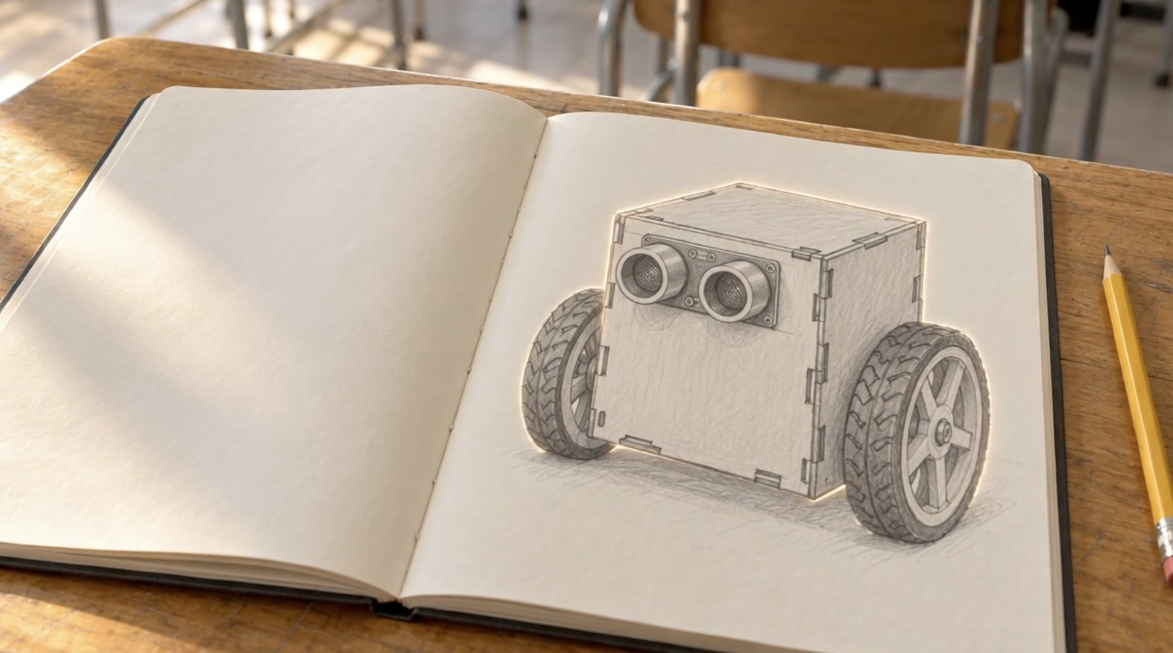
Robot Comes to Life

Slide 87
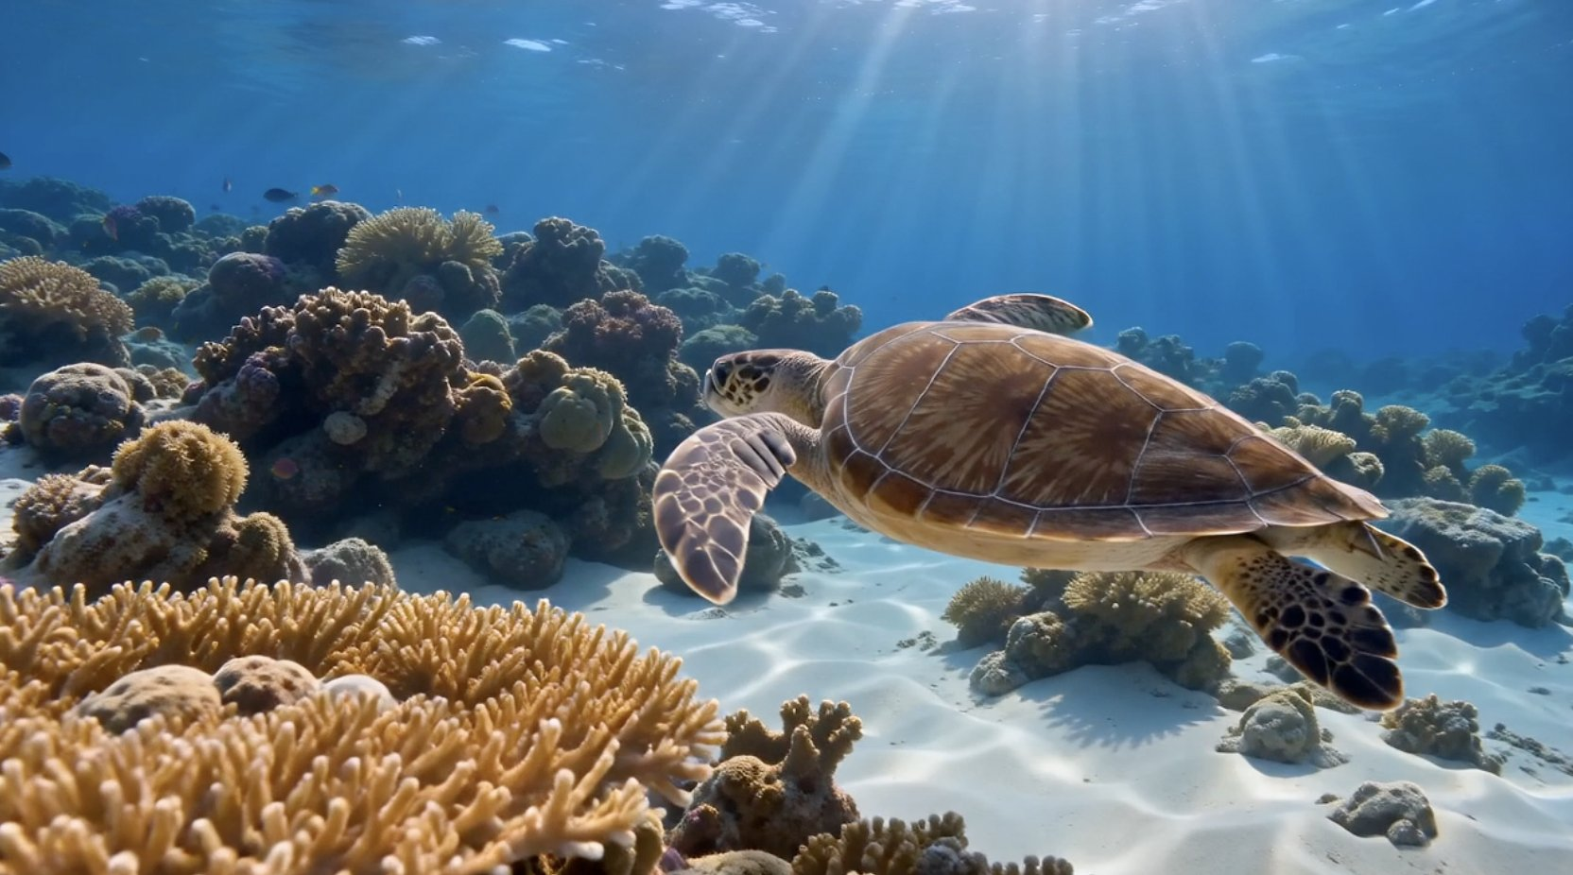
Underwater Marine Life

Slide 88
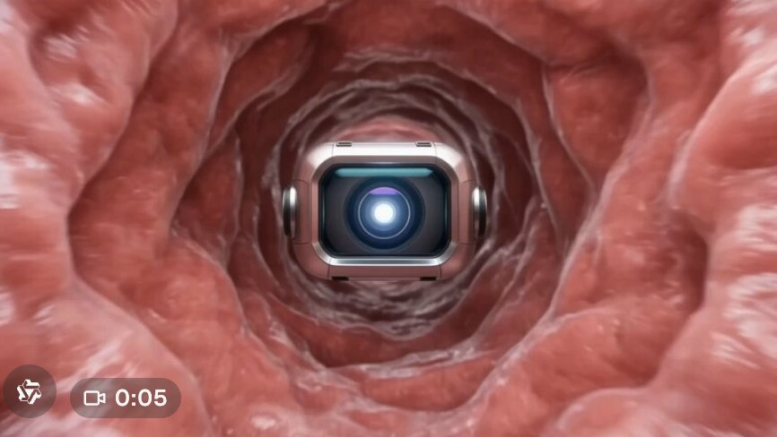
Inside a Blood Vessel

Slide 89
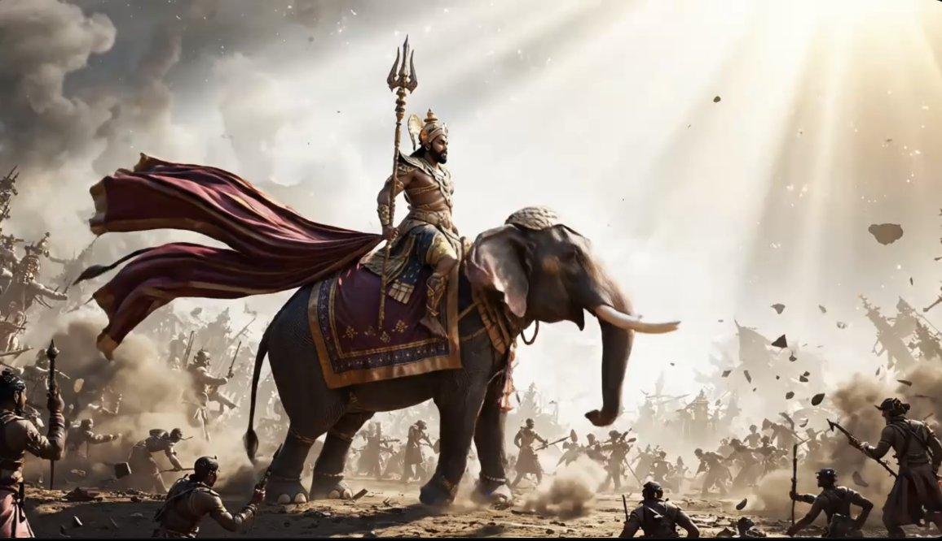
A King Flies to Space on his Elephant

Slide 90
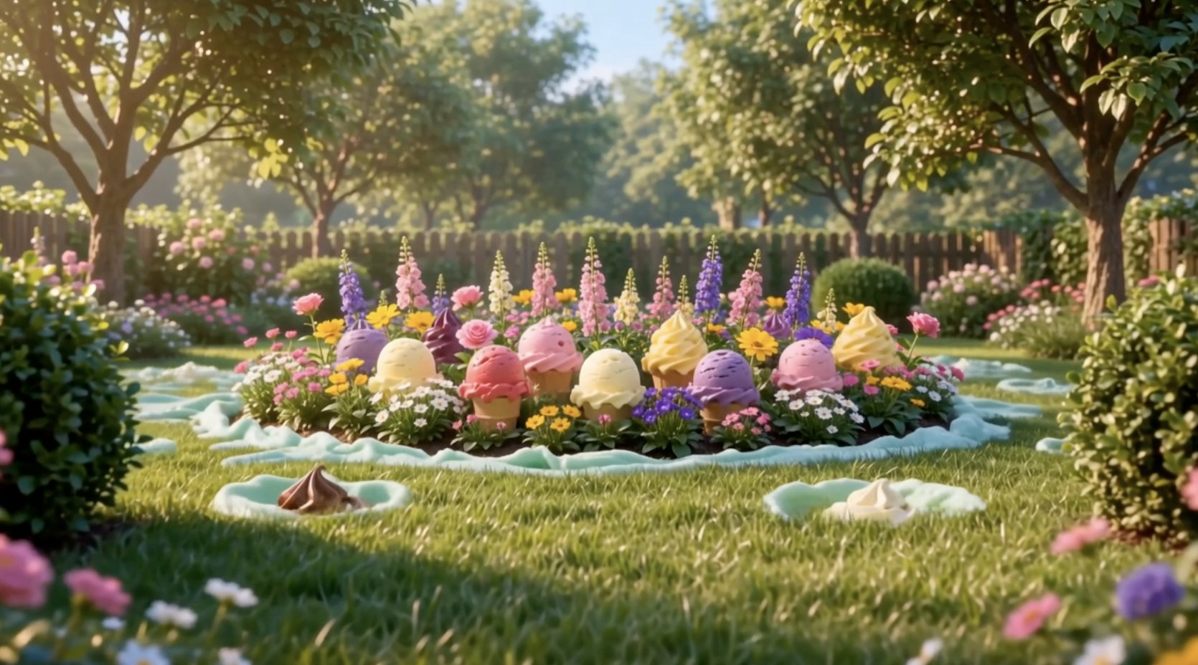
Chocolate Garden

Slide 91
  AI - Helps You or Holds You Back
Used Well
Save time, tutor, explain, generate alternatives, help code, simulate, critique and prototype
Learn faster, ask better questions, research, practice, create, test ideas.
Used Badly:
Waste time, encourage dependence and replace thinking

Slide 92
You can’t control the tides of life.
You can only learn to steer your own boat.

Slide 93
Test Yourself
Final Classroom Activities

Slide 94
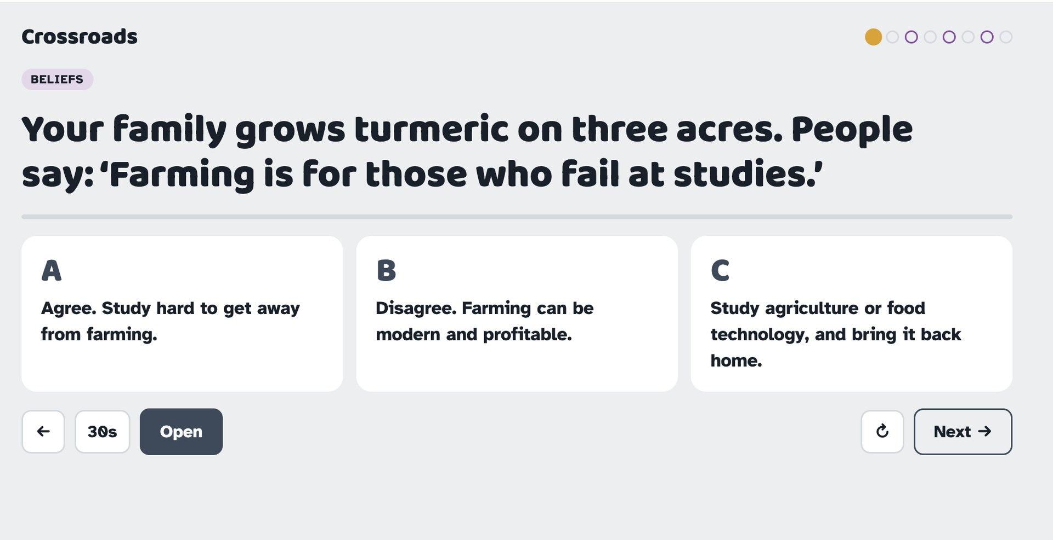
CrossRoads Game – What Choice Will You Make

Slide 95
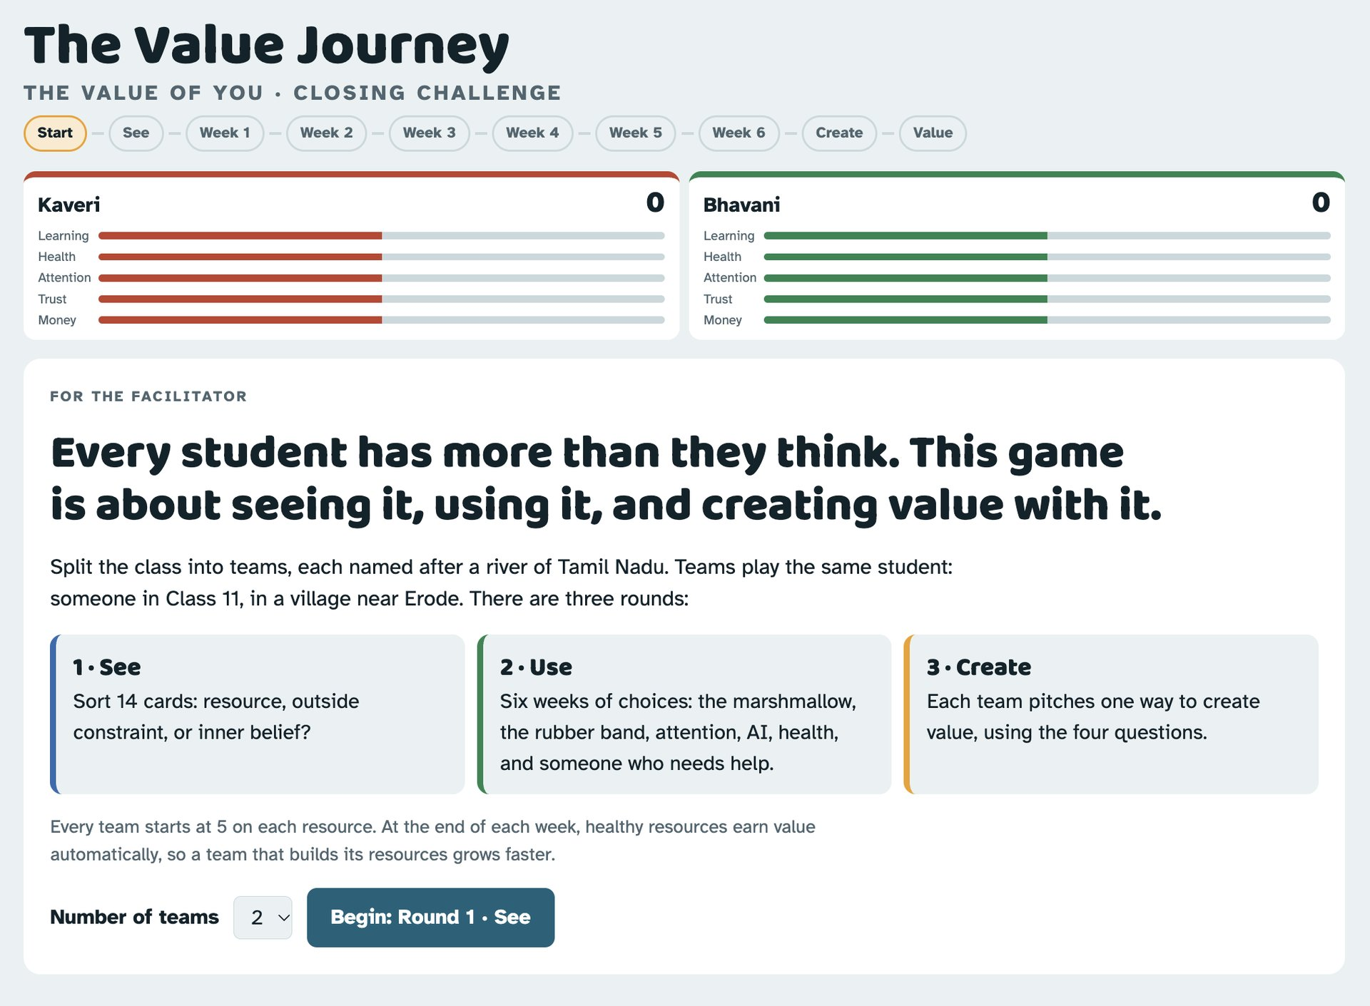
The Value Journey

Slide 96
The Value of You
A Programme by Timeless Lifeskills Foundation
Our WhatsApp Channel
Our Instagram
Our Website

